Slide 1

Oracle HCM NEXT05 _ CAI1_ERP3_M1e
Project 2: Oracle HCM Enterprise Structure Setup and Management|
Group 1
Nesma Nour Elden
Aya Elsayed
Samer Morsi
Rowan Mohamed
Somia Afifi
Alaa Allah Ayman
Notes:
Oracle HCM

Slide 2
Project Goals
To guide the user through the setup and management of the enterprise structure, including creating:
business units.
legal entities departments, and job roles in Oracle HCM.

Slide 3
Description
Company Name: RSM
Industry: Automotive
Company Type: Partnership
NU. Of Divisions: 7
Head Count: 250:300
Founded: 2010
Location: Cairo, Egypt – Saudia Arabia

Slide 4
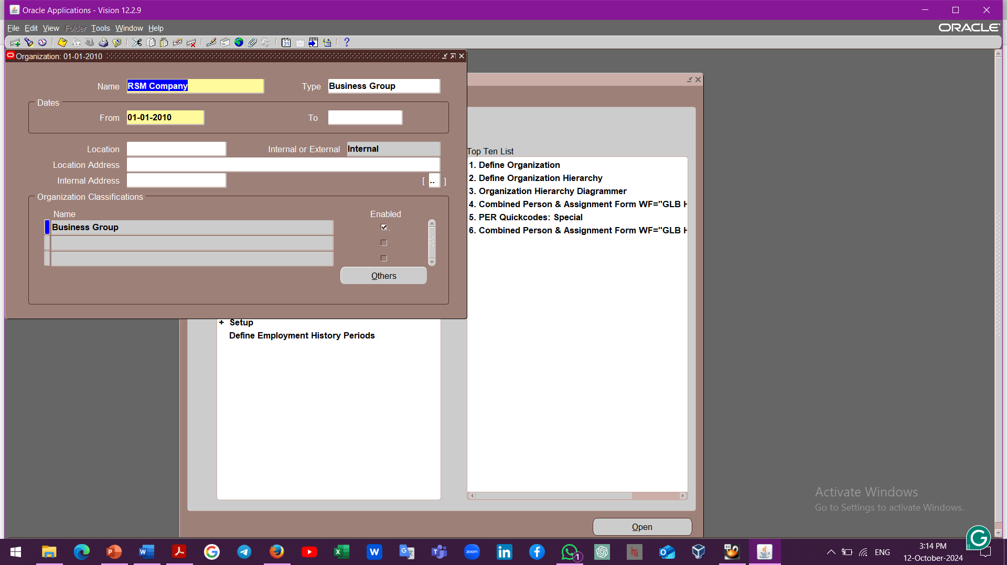
Enterprise Structure Setup
We Will Start with HR Core and specifically with Work Structure.

Slide 5
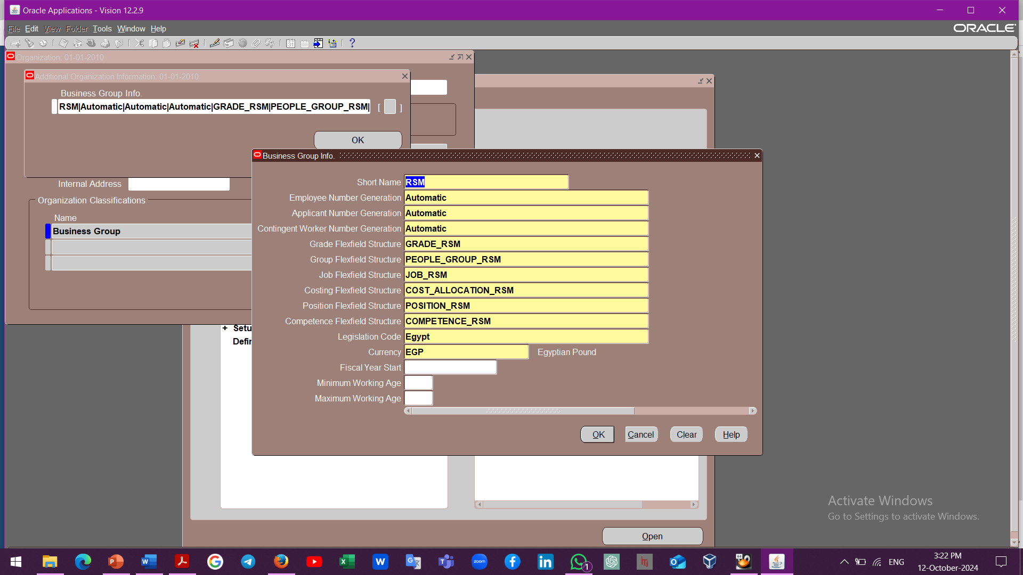
Enterprise Structure Setup
To Configure a business Group or Company on a system we Should first Create their 6 Key Flex fields
Grade
Job
Position
Competence
Cost allocation
People Group

Slide 6
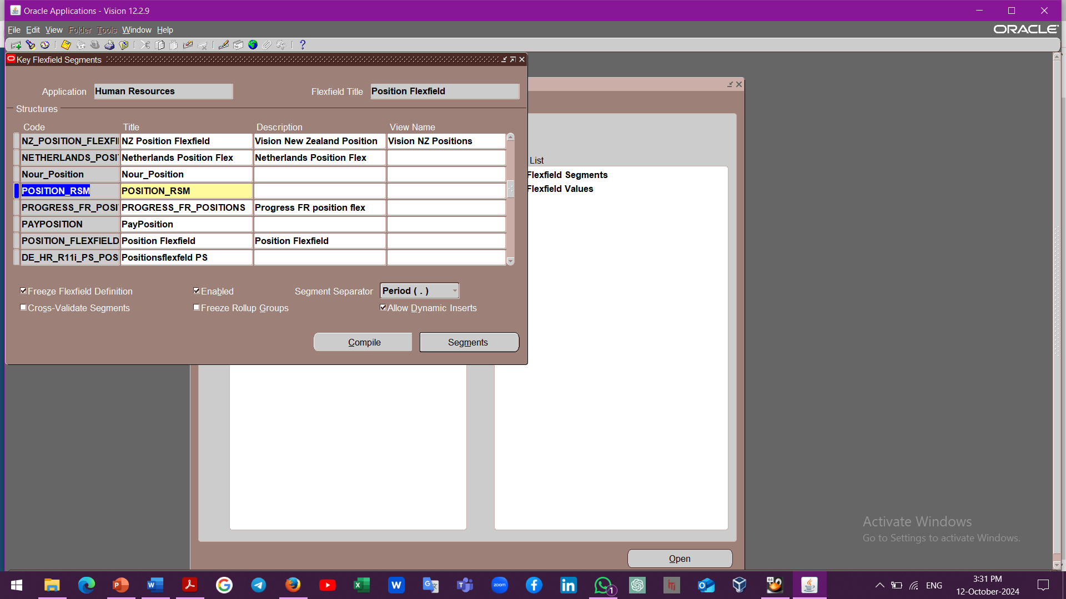
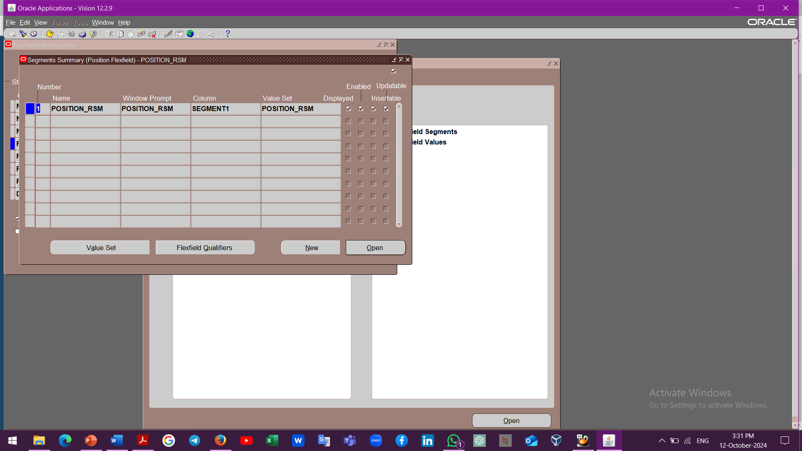
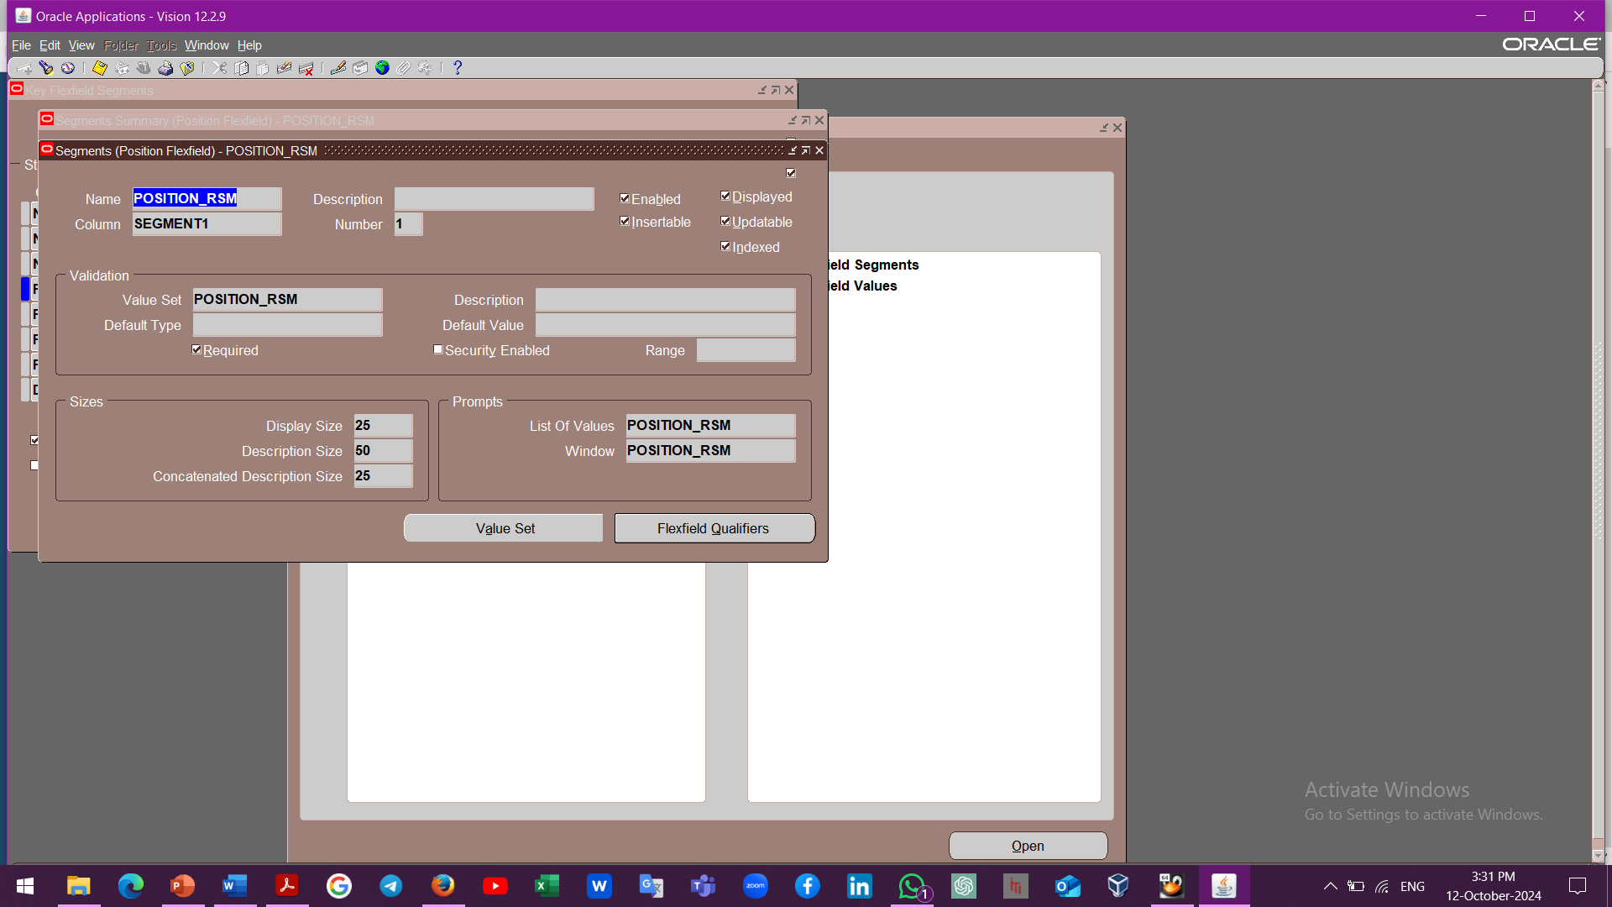
Enterprise Structure Setup
To Create the 6 Key Flex Ifield
System Administrator
Application
Flex field
Key
Segment

Slide 7



Enterprise Structure Setup
Job Flex field

Slide 8

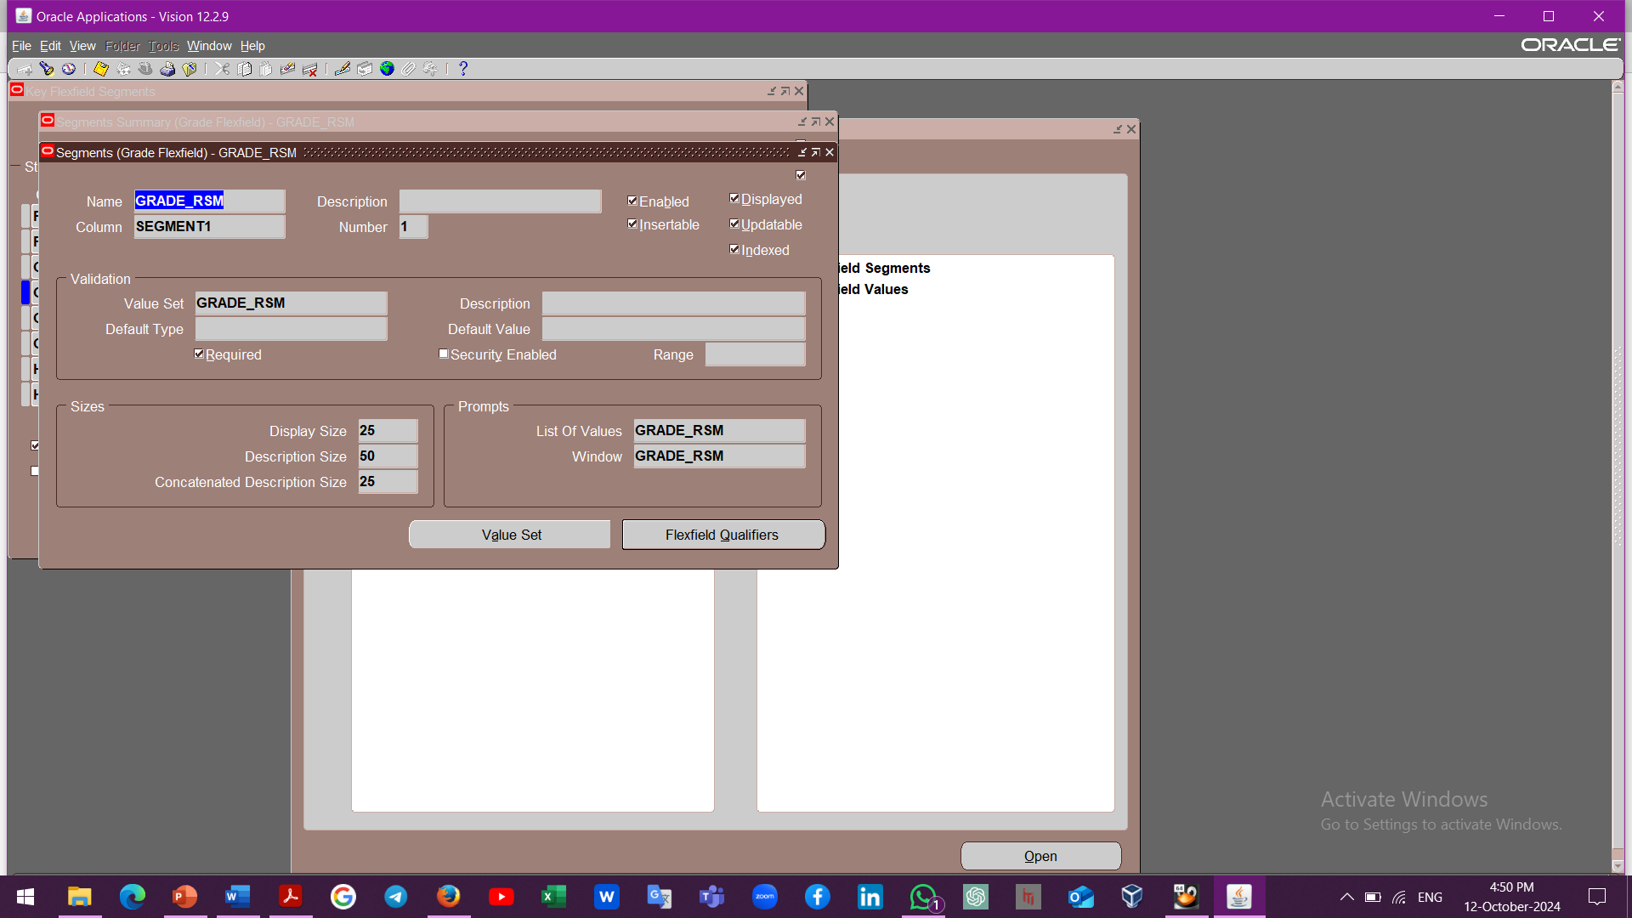

Enterprise Structure Setup
Grade Flex field

Slide 9
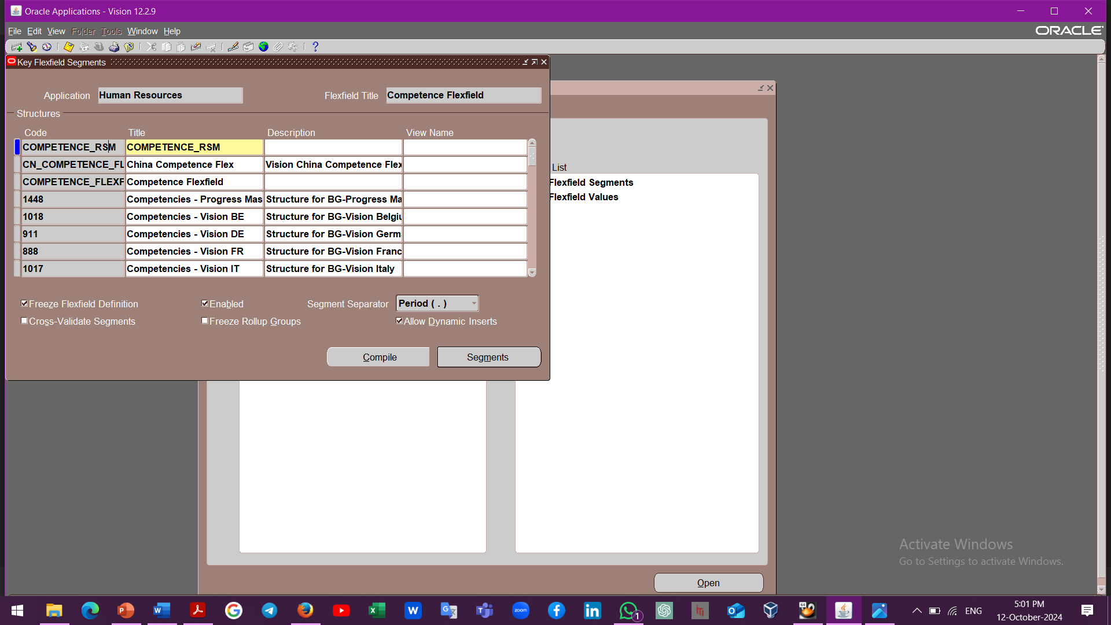
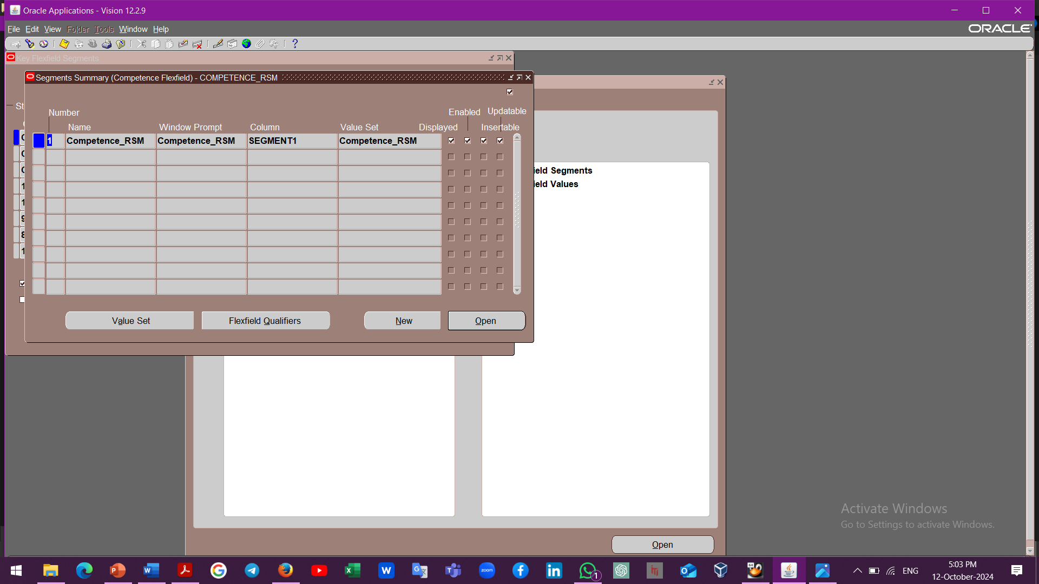

Enterprise Structure Setup
Competence Flex field

Slide 10
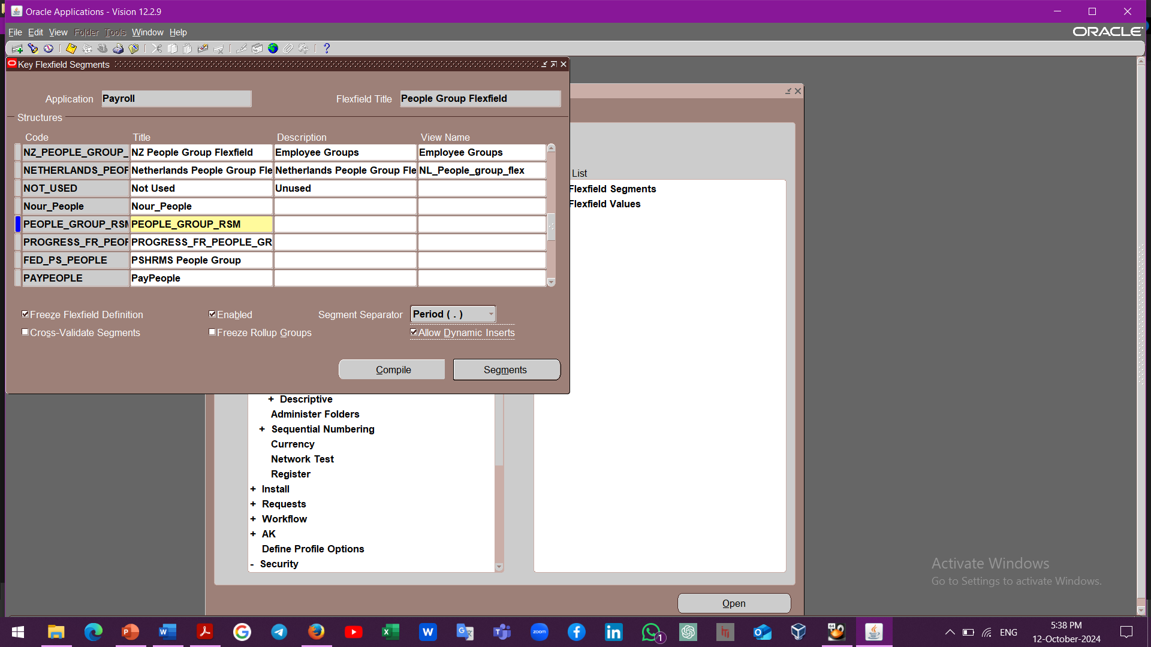
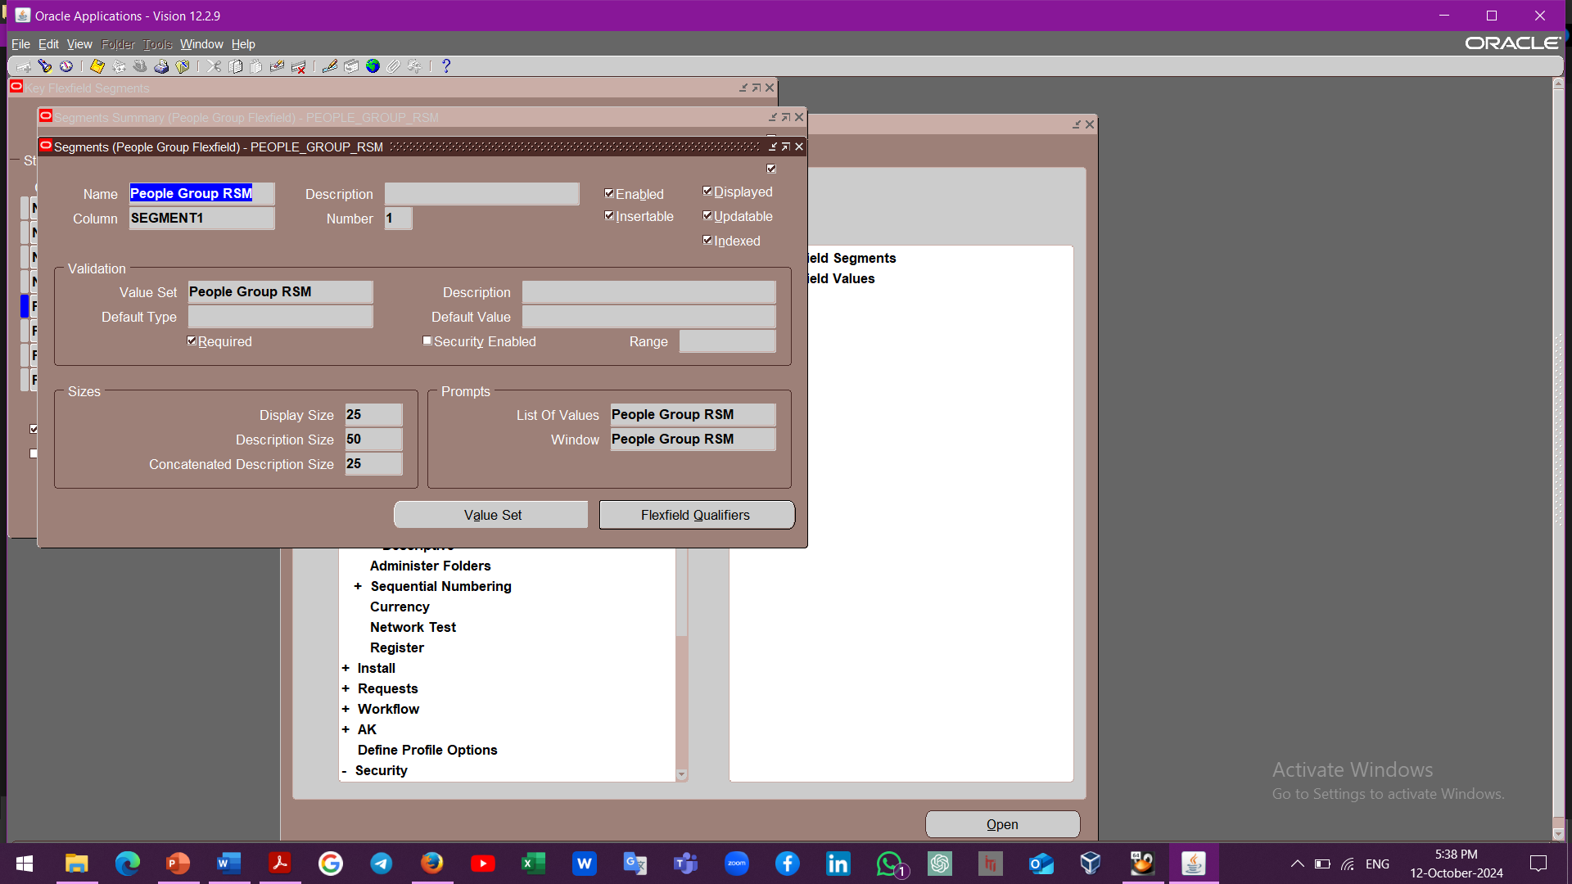
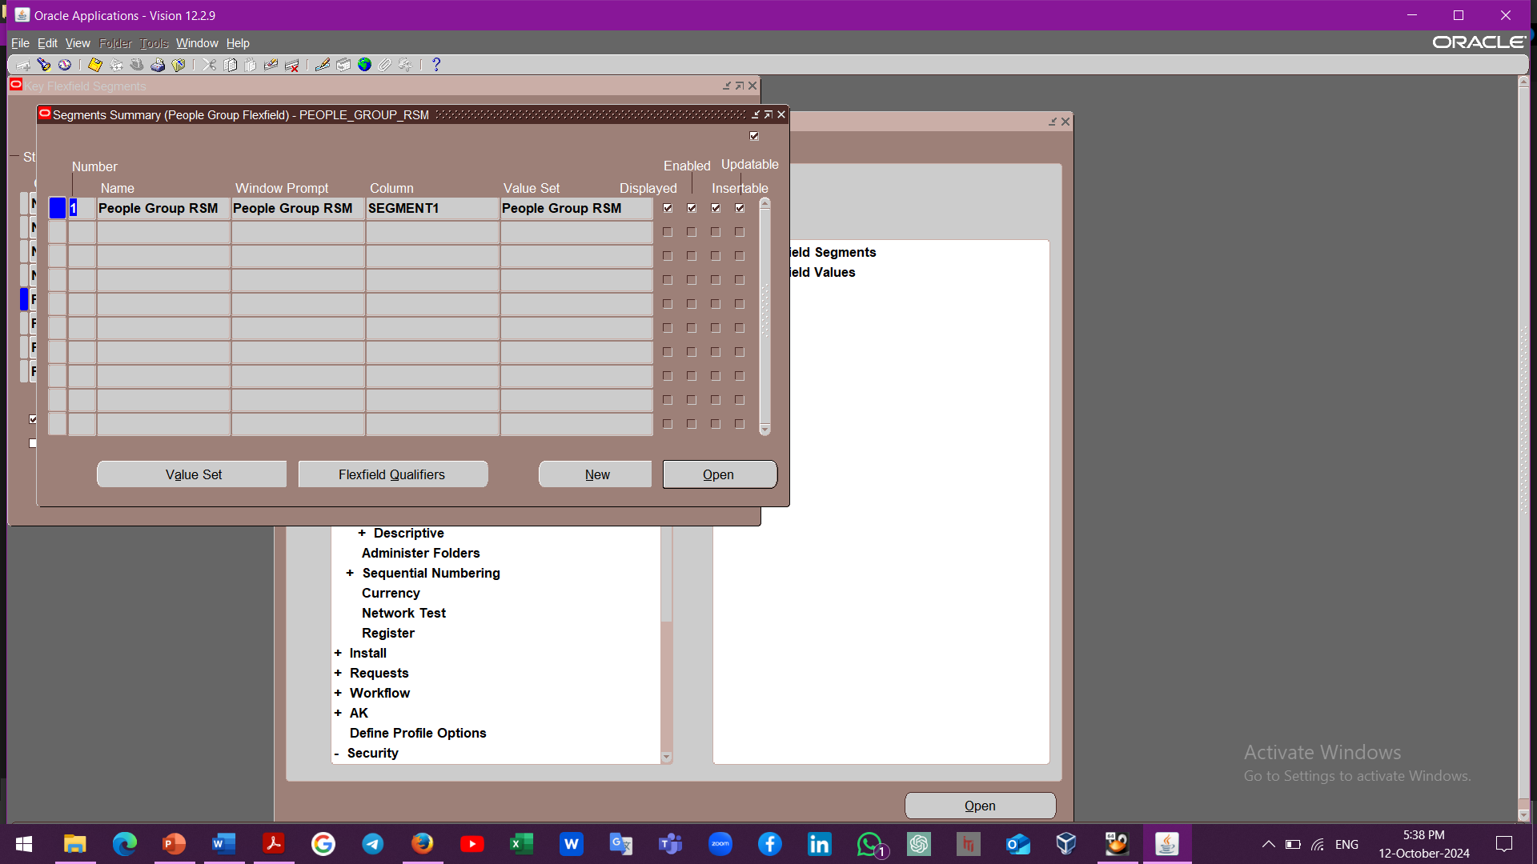
Enterprise Structure Setup
People Group Flex Filed

Slide 11
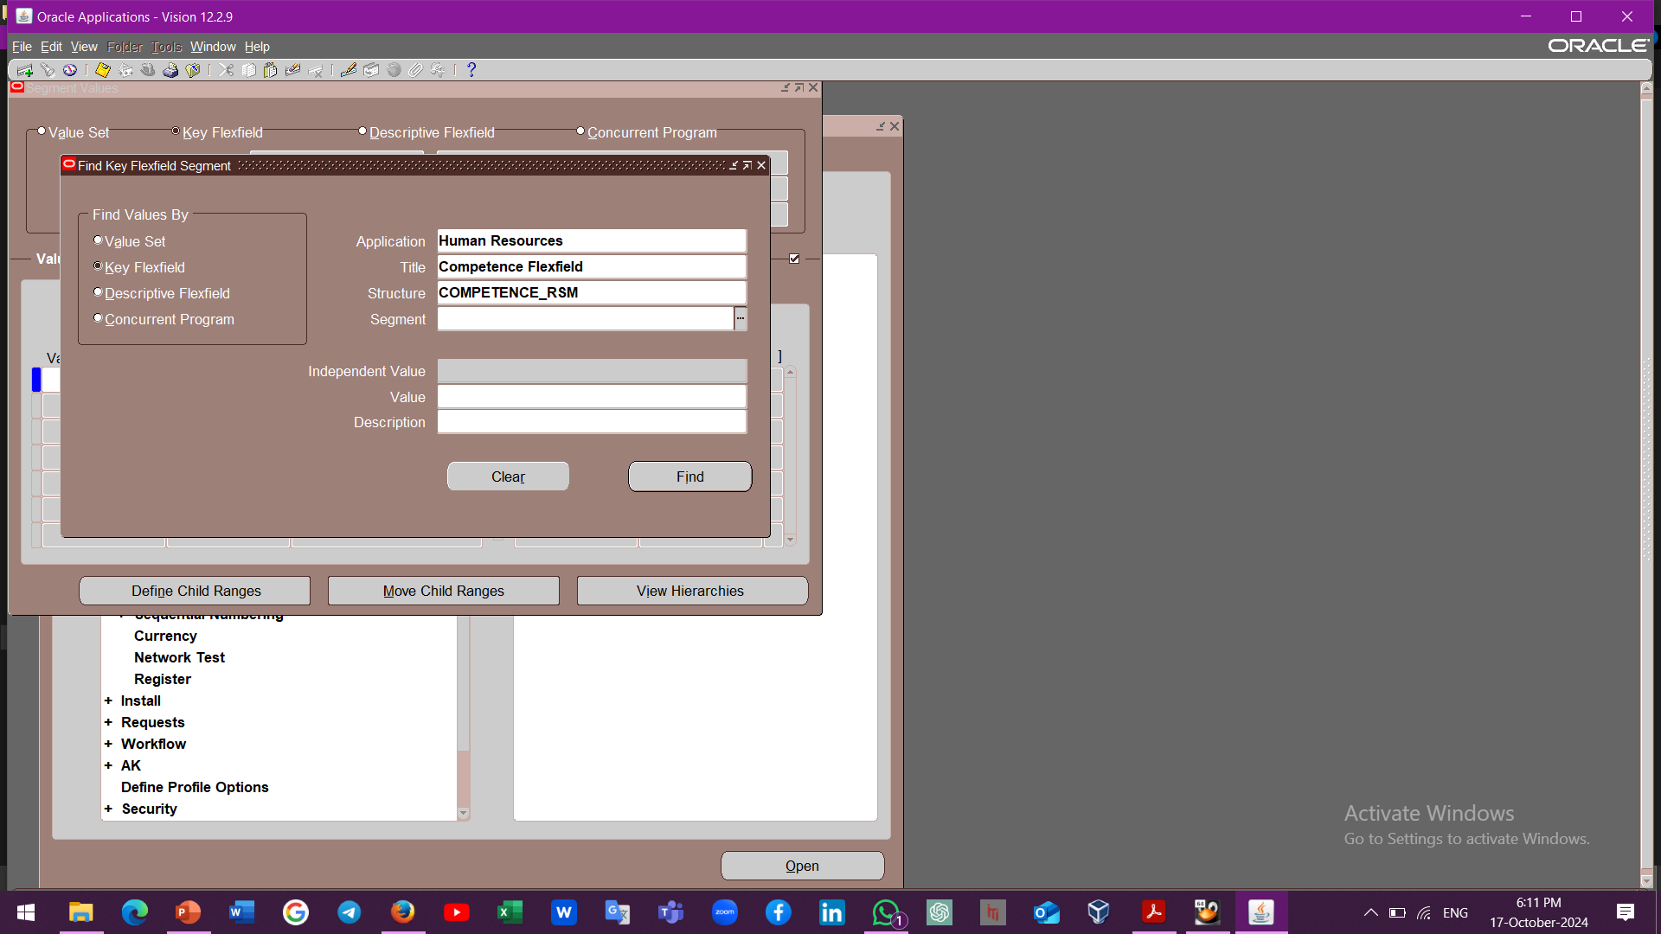
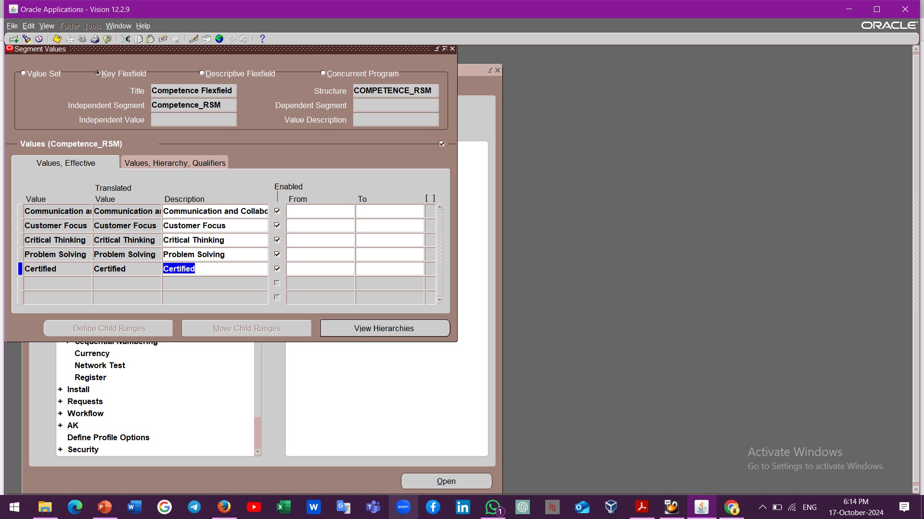
Enterprise Structure Setup
Competence Flex Filed
2
1

Slide 12
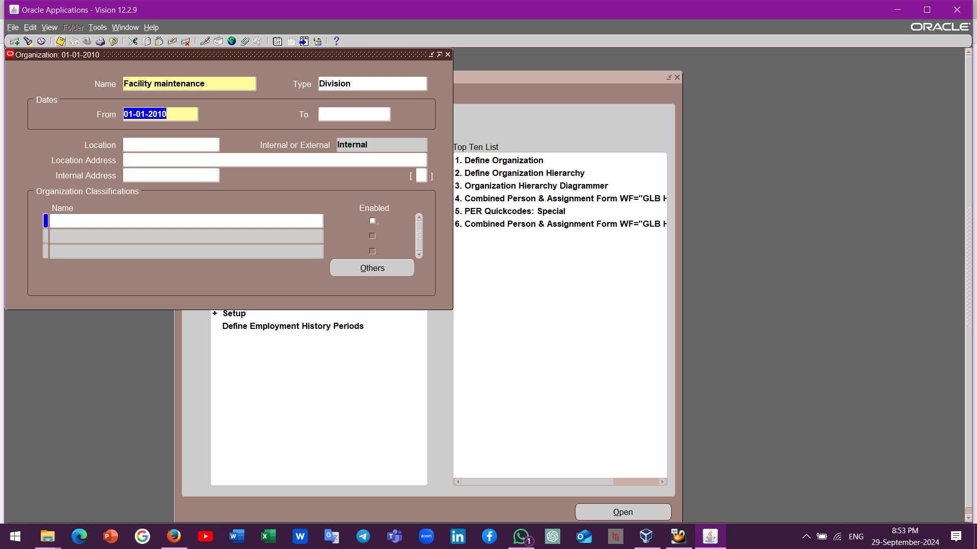
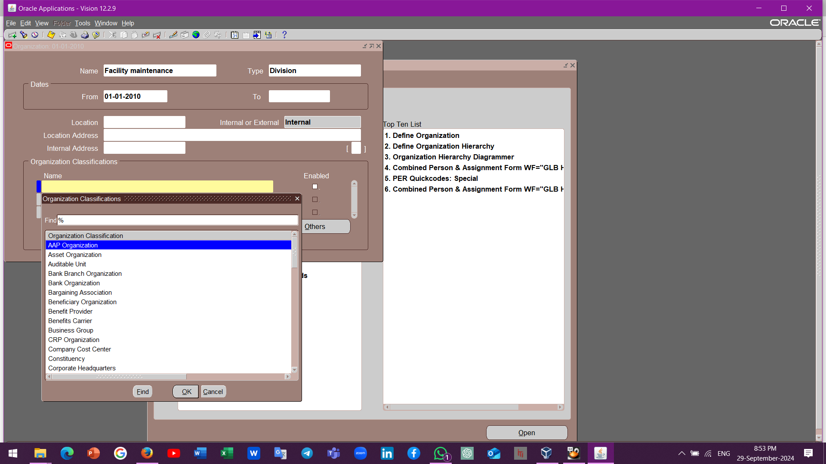
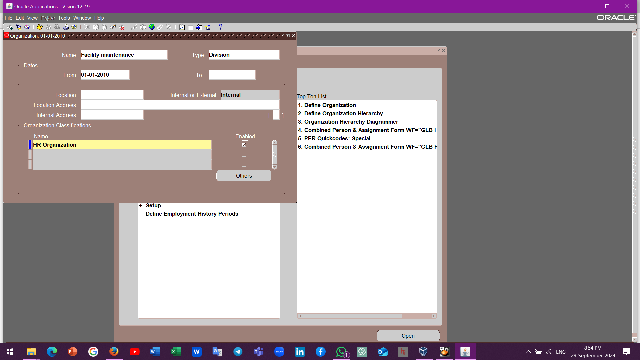
Enterprise Structure Setup
Creating Divisions, Departments, and sections of the company
Global HRMS Manager
Work Structure
Organization
Description
New

Slide 13
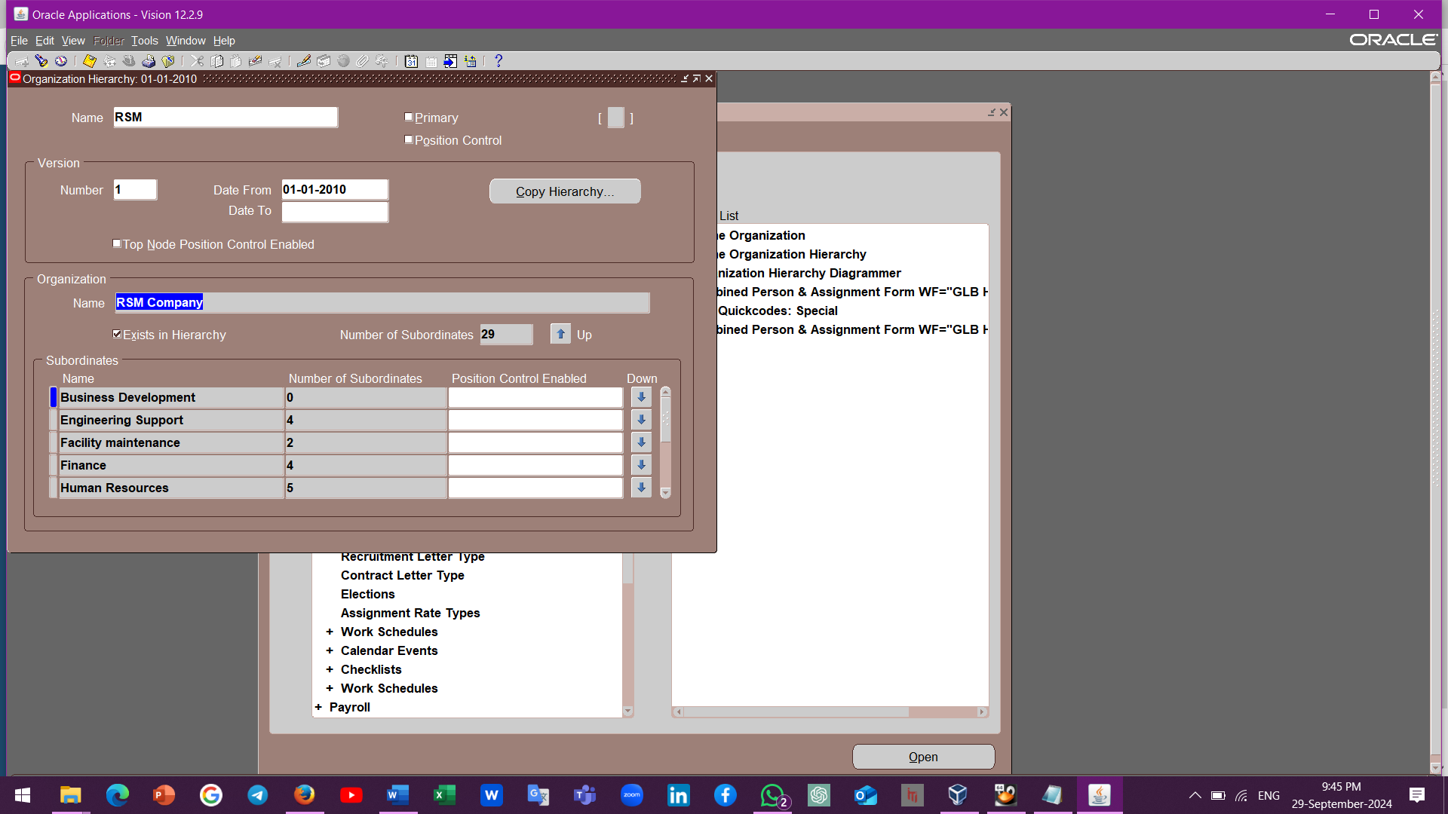
Enterprise Structure Setup
Global HRMS Manager
Work Structure
Organization
Hierarchy
New

Slide 14


Human Resources Division

Slide 15

Engineering Support Division

Slide 16
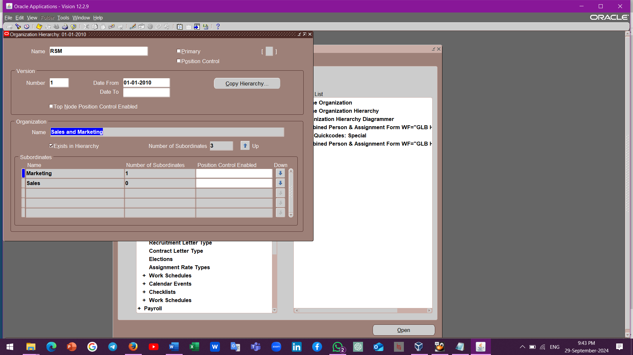

Sales & Marketing Division

Slide 17
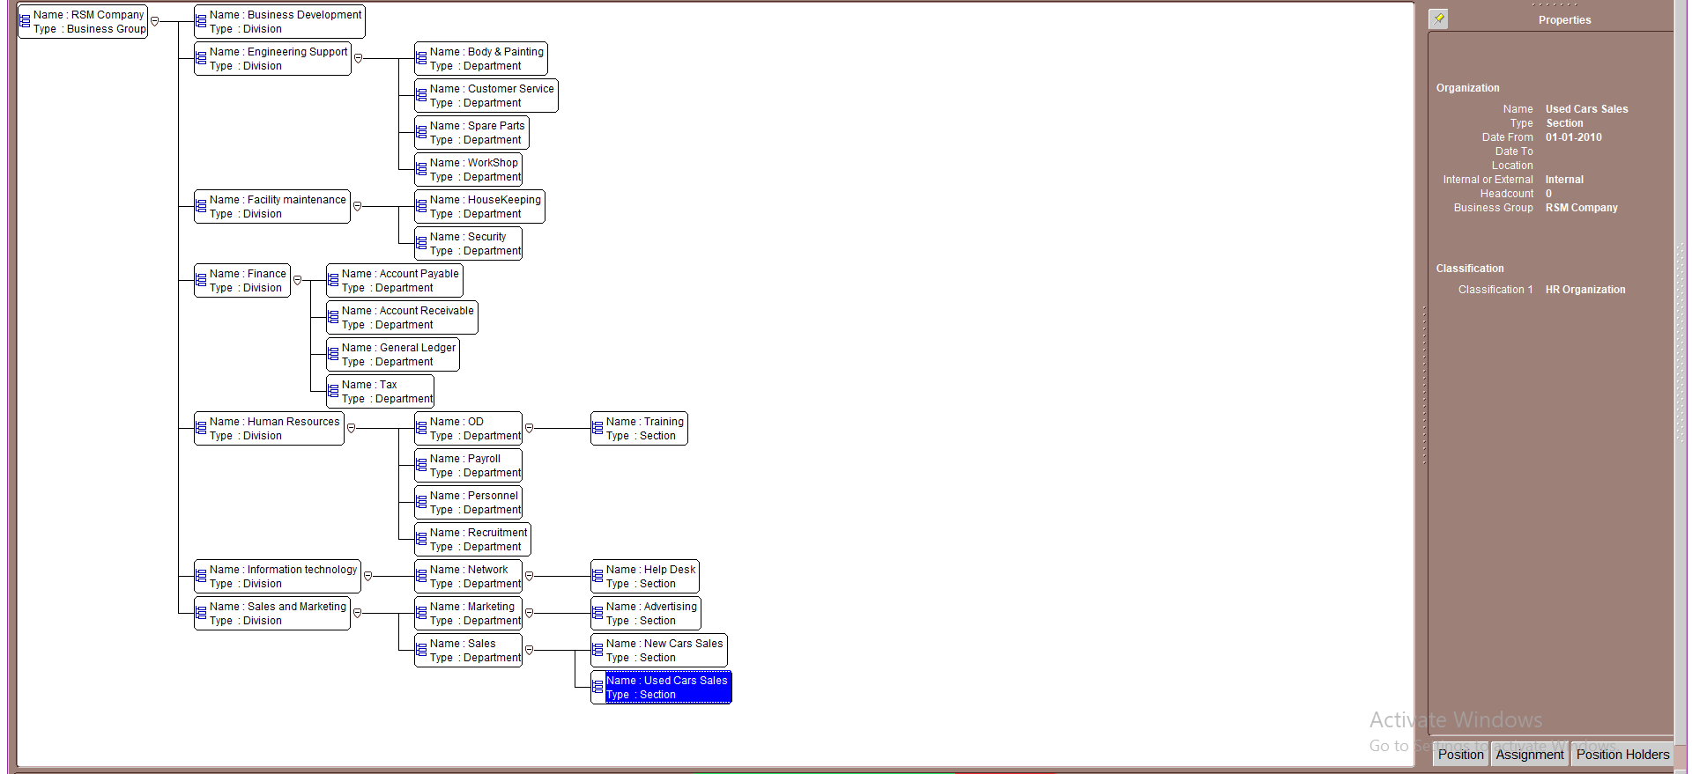
The Full Diagram of the organization.

Slide 18
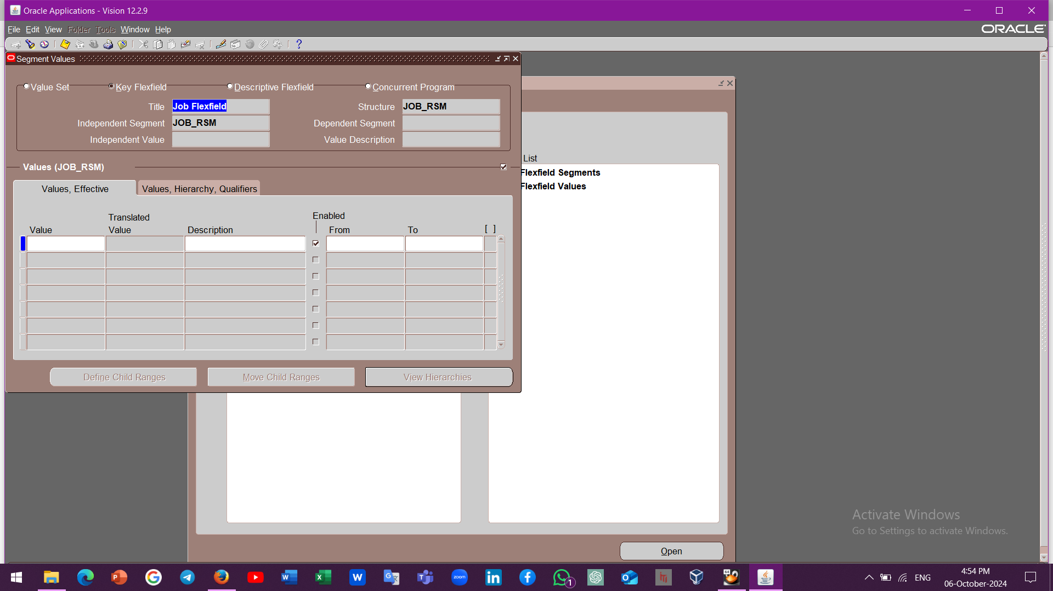
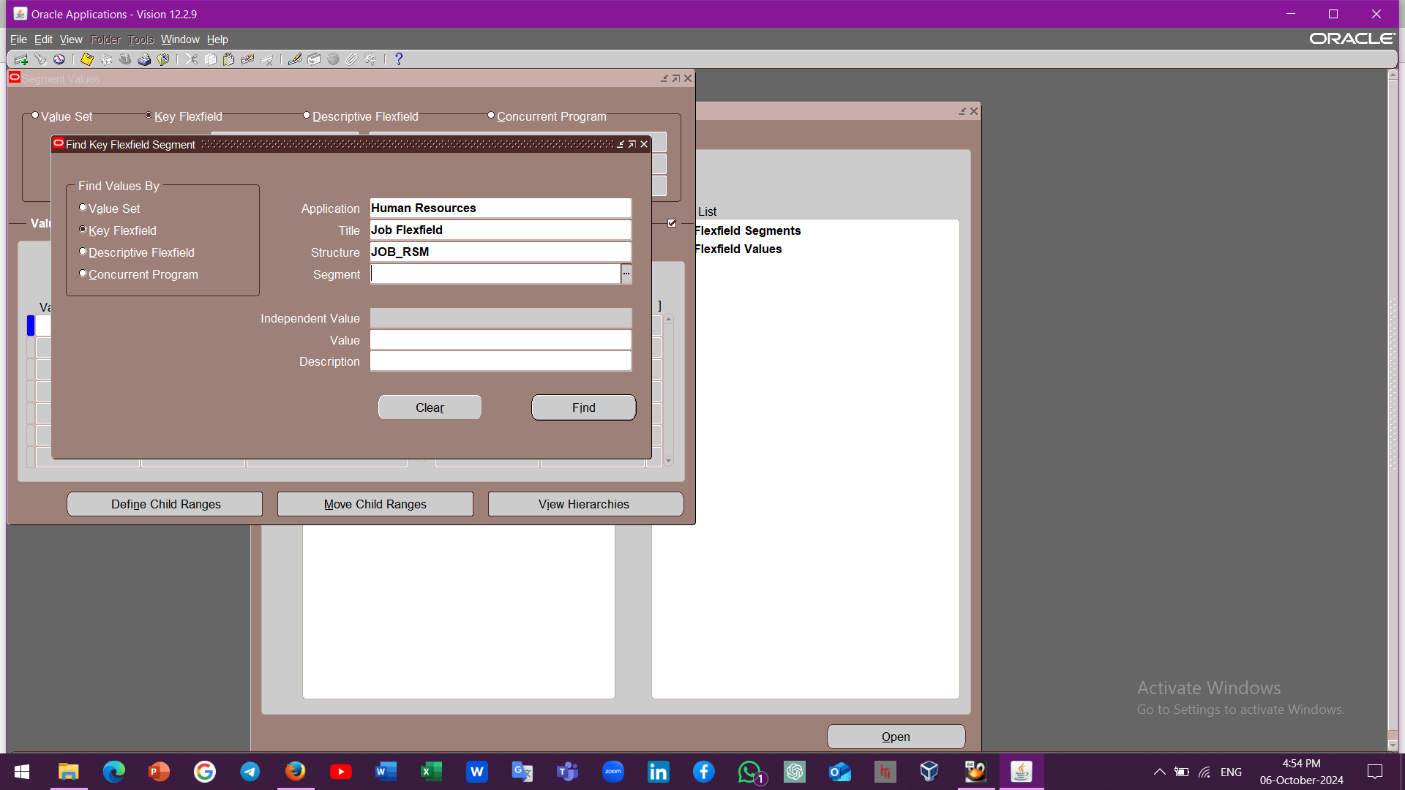

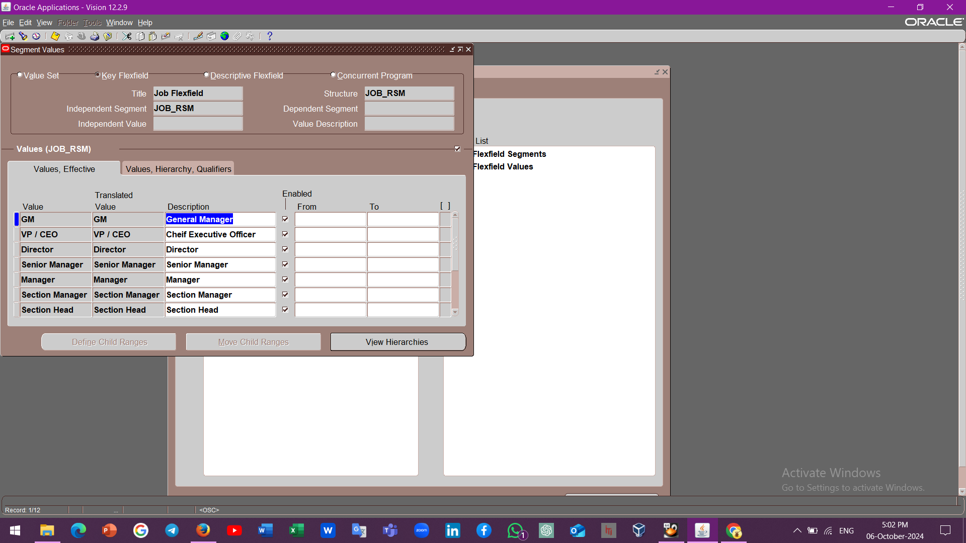


Job and Position Management
System Administrator
Application
Key
Flex Field
Values

Slide 19
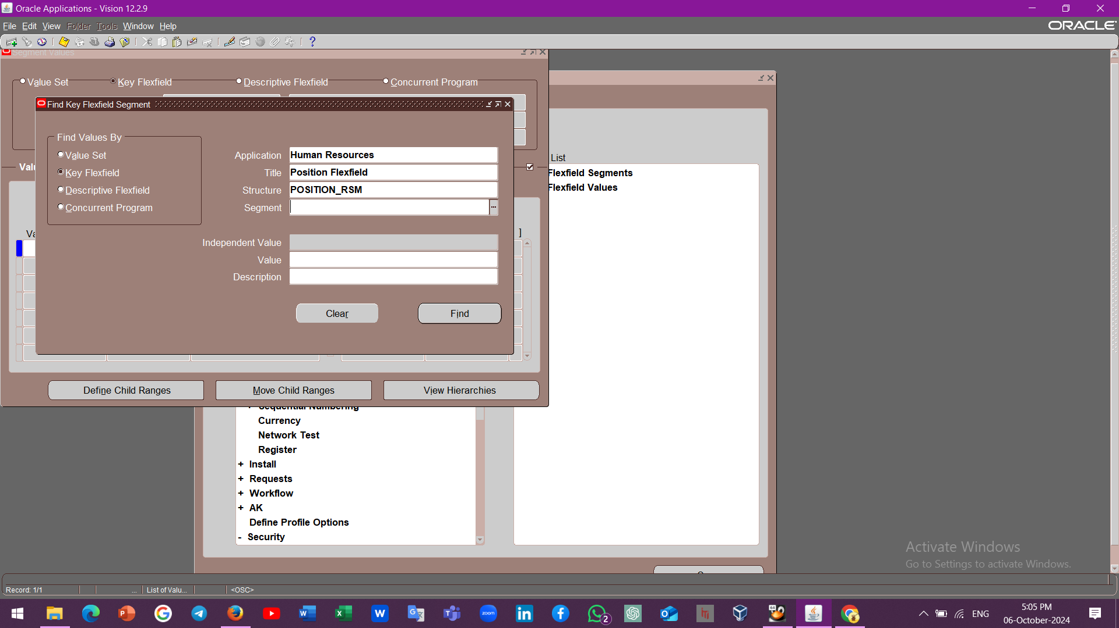
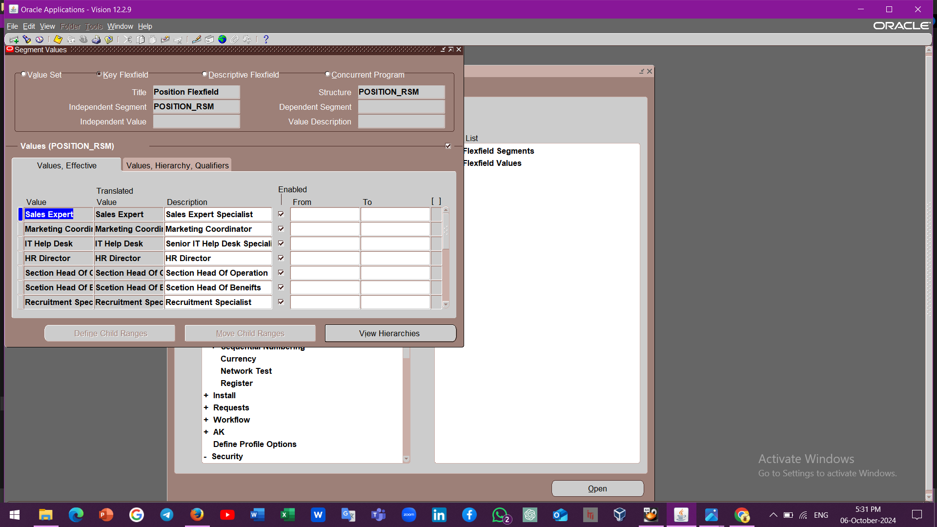
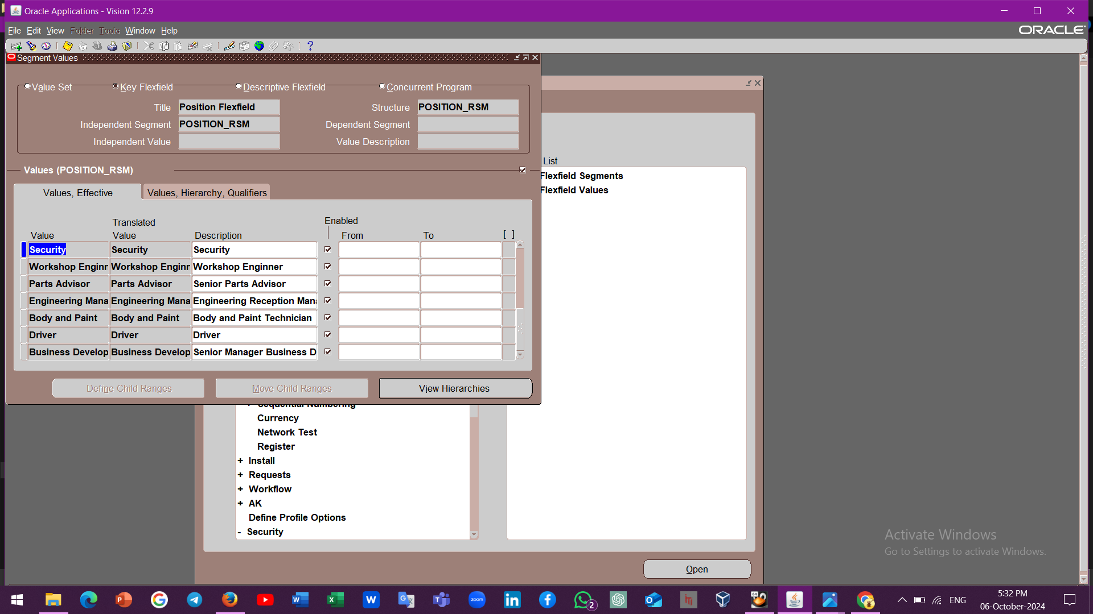
Job and Position Management

Slide 20
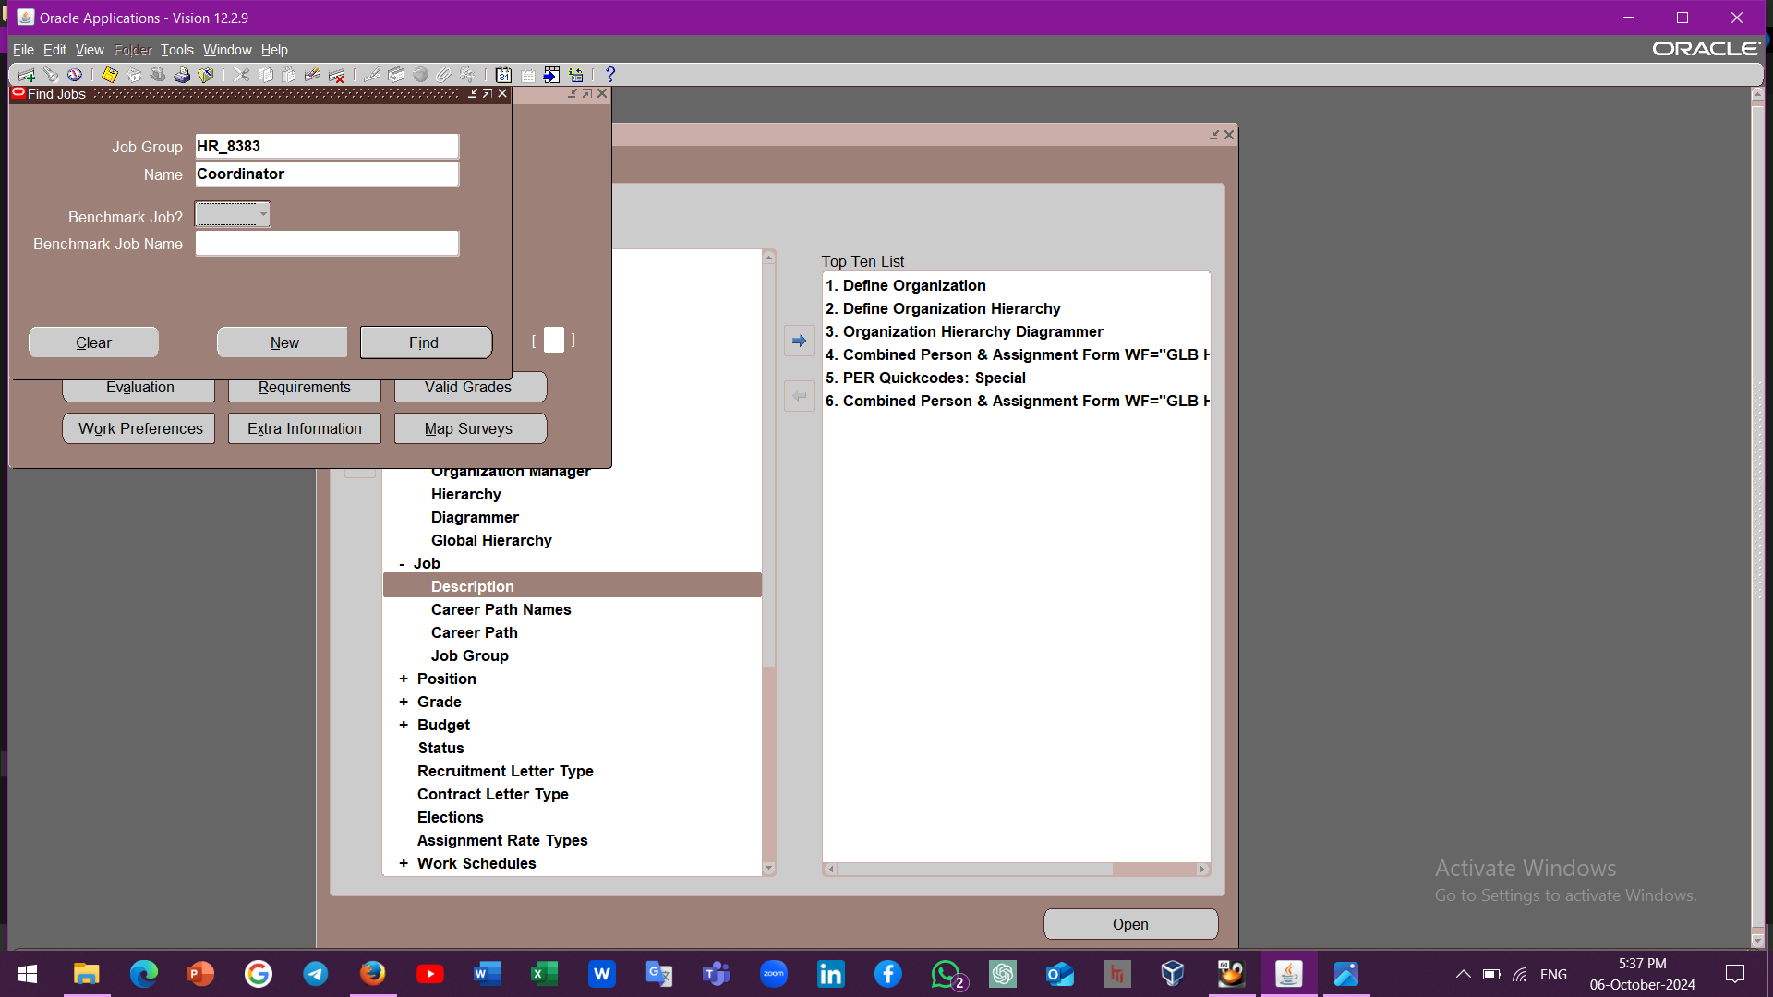
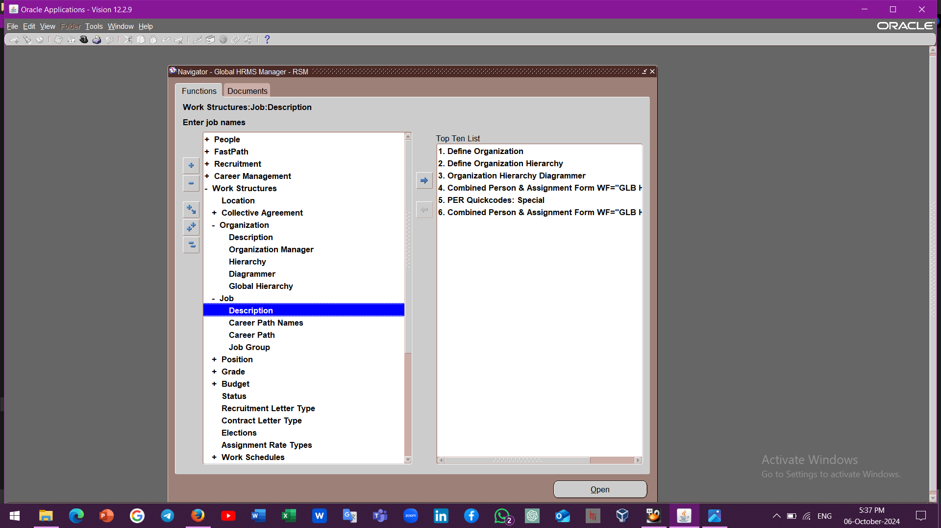
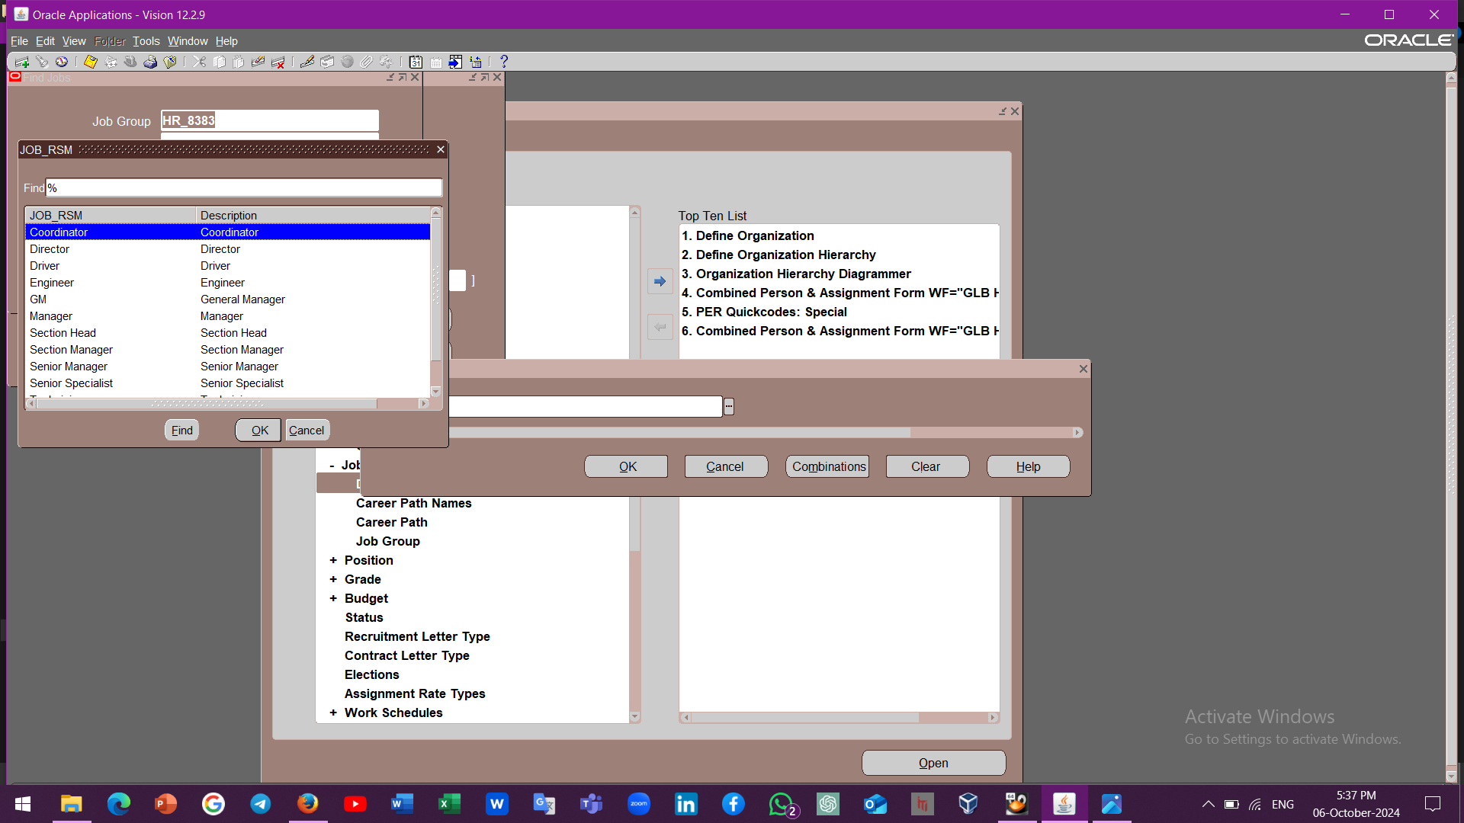
Job and Position Creation
3
1
2

Slide 21
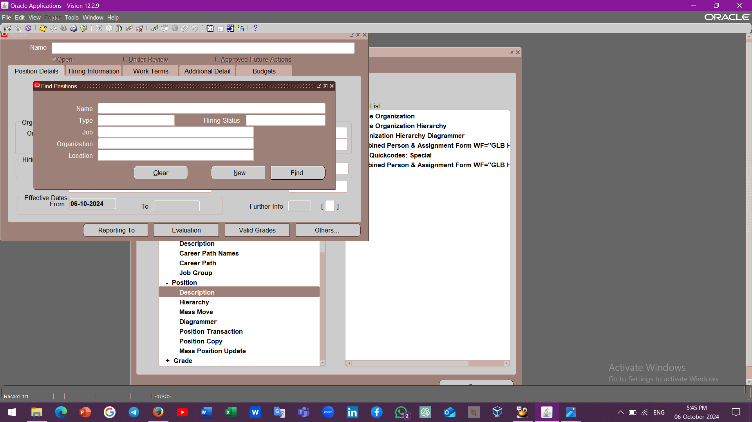
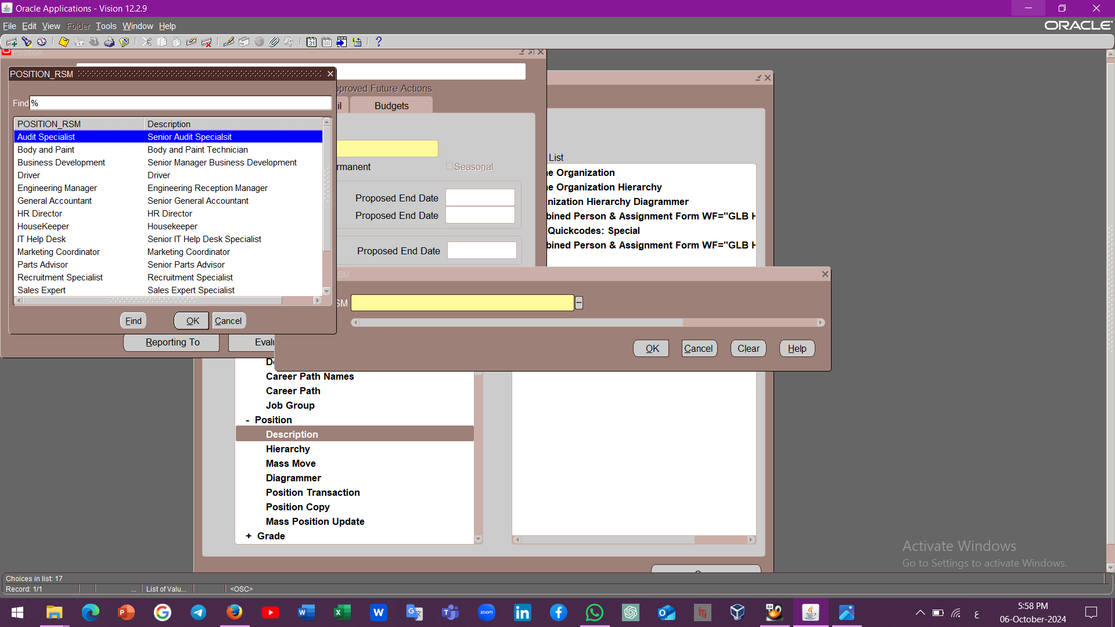
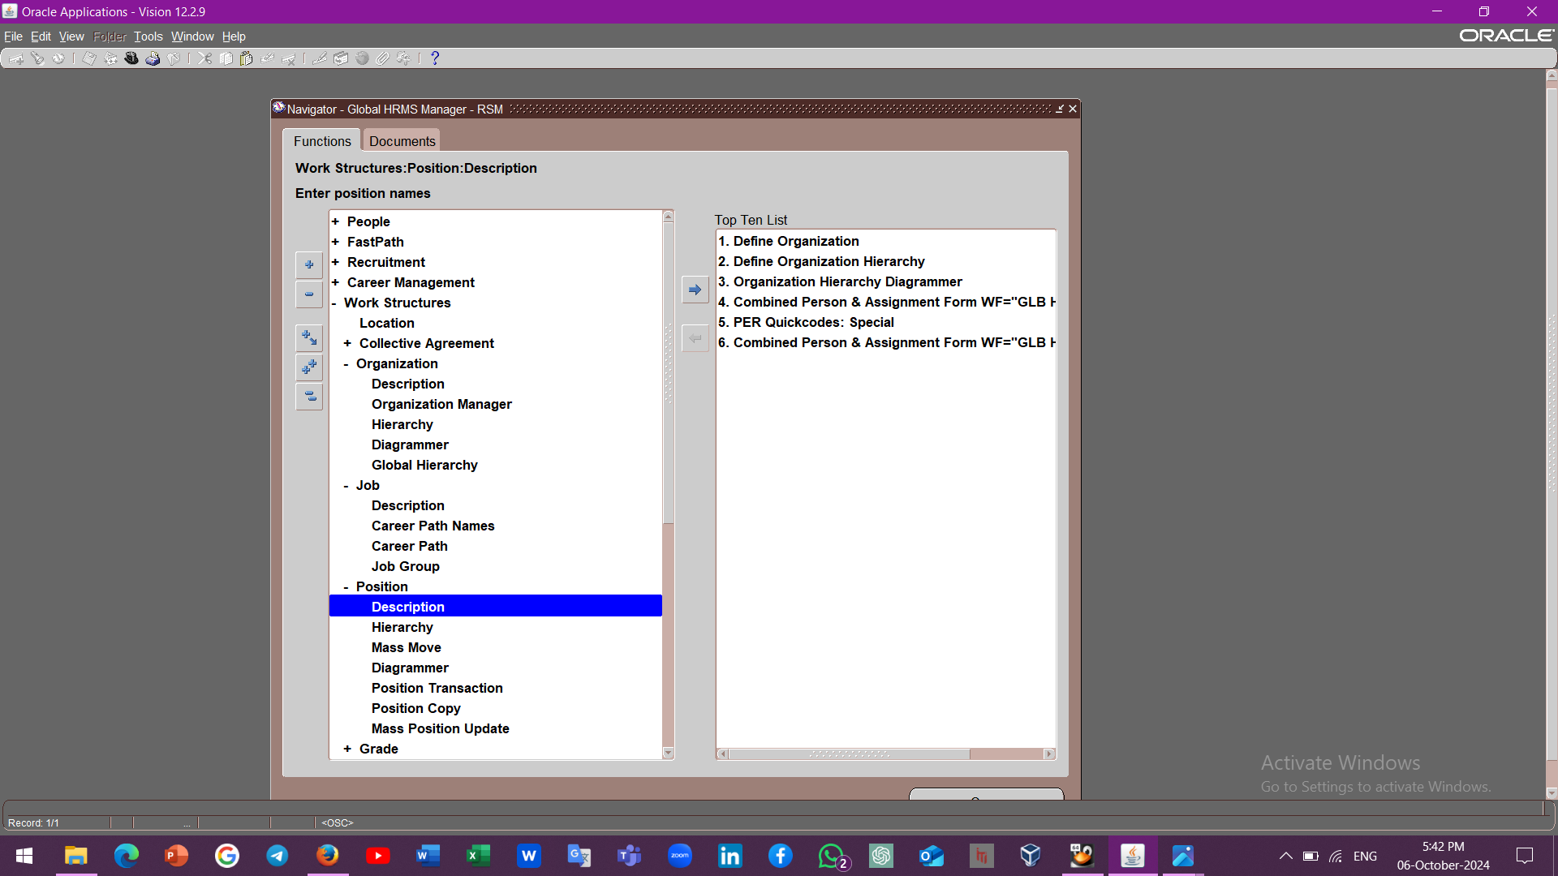
Job and Position Creation

Slide 22
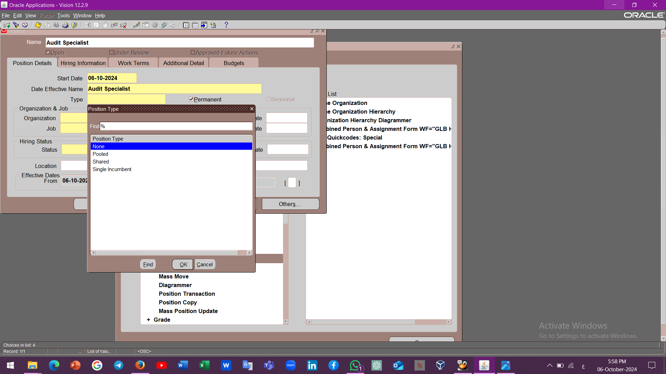
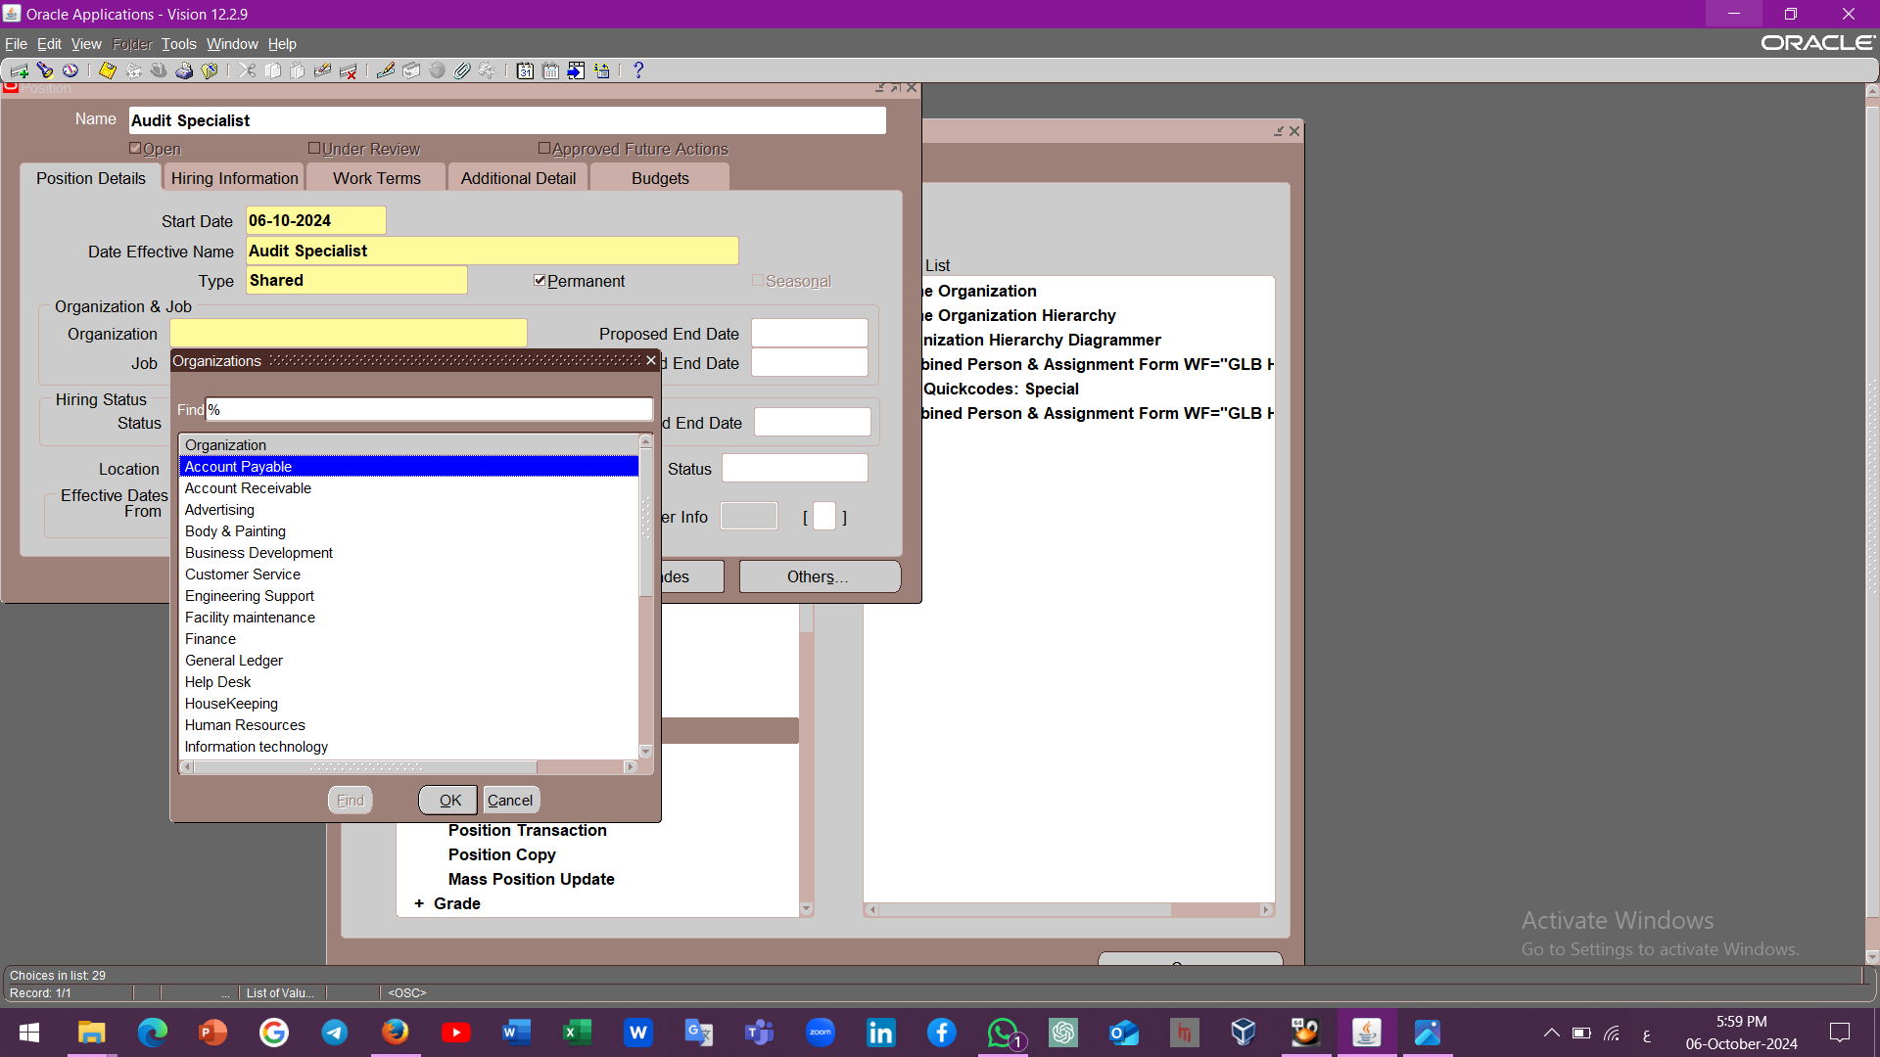
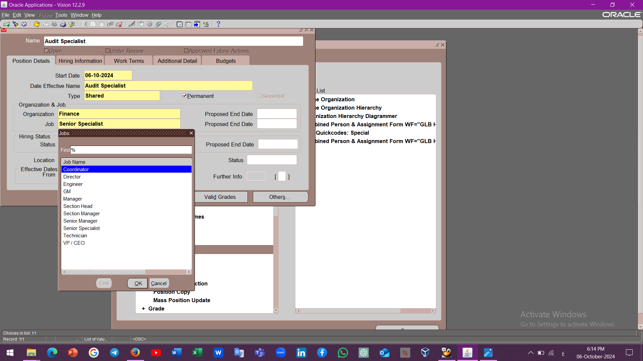
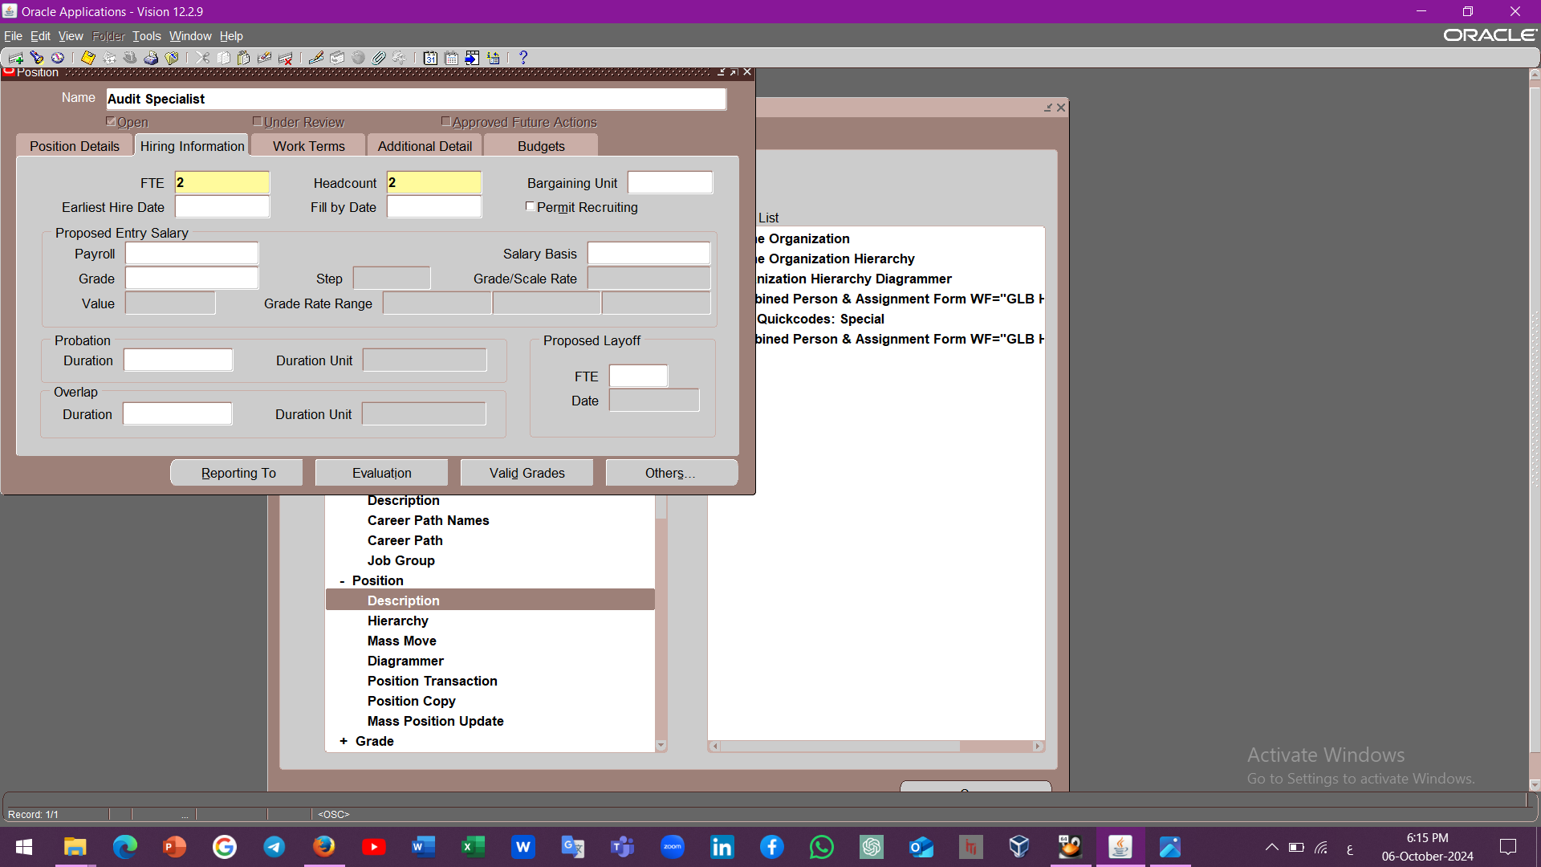
Job and Position Creation
1
2
3
4

Slide 23
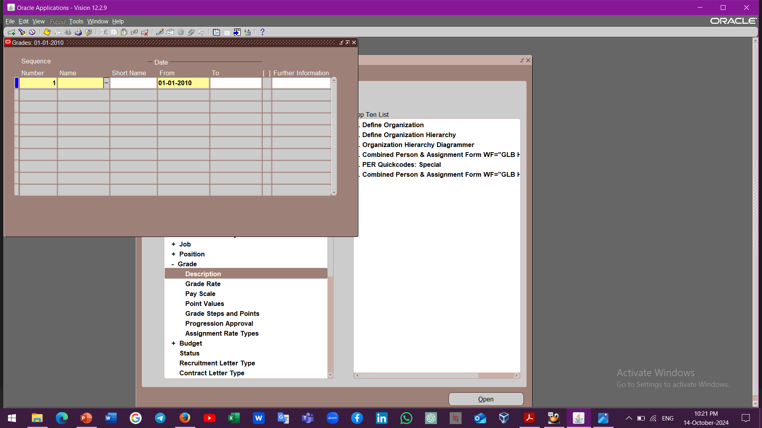
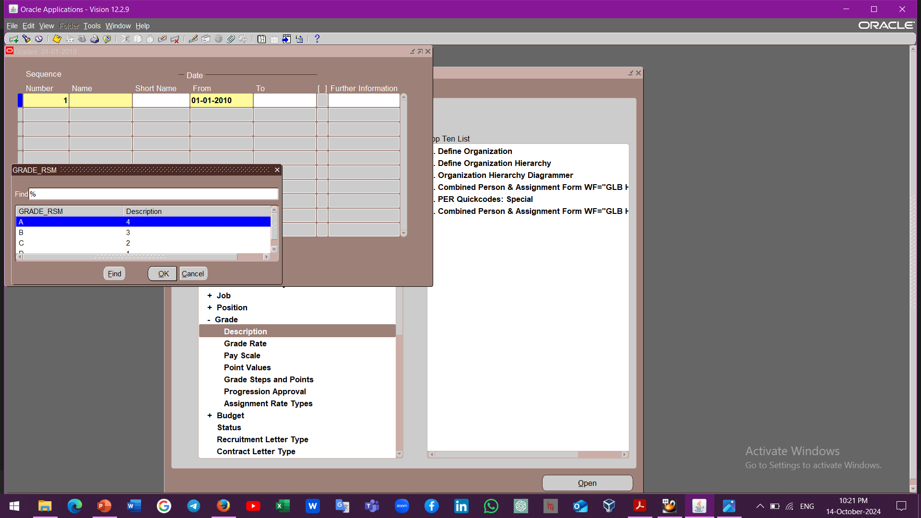
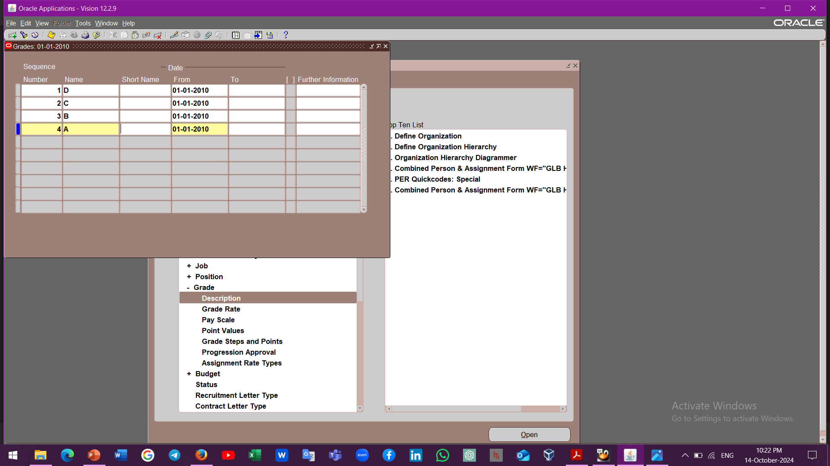
Grade Creation

Slide 24
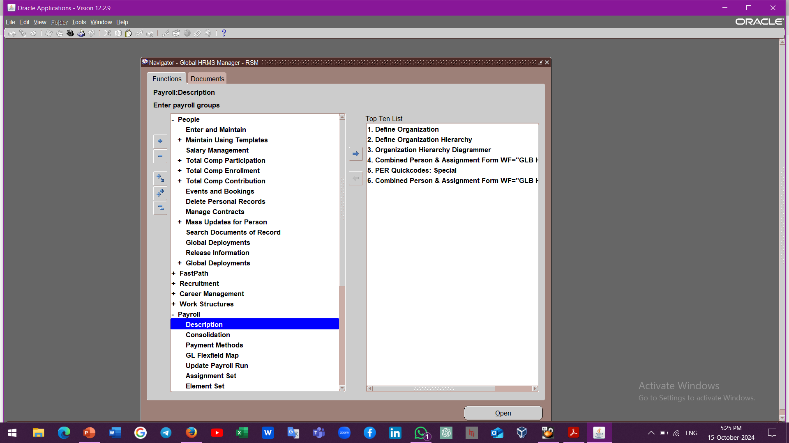
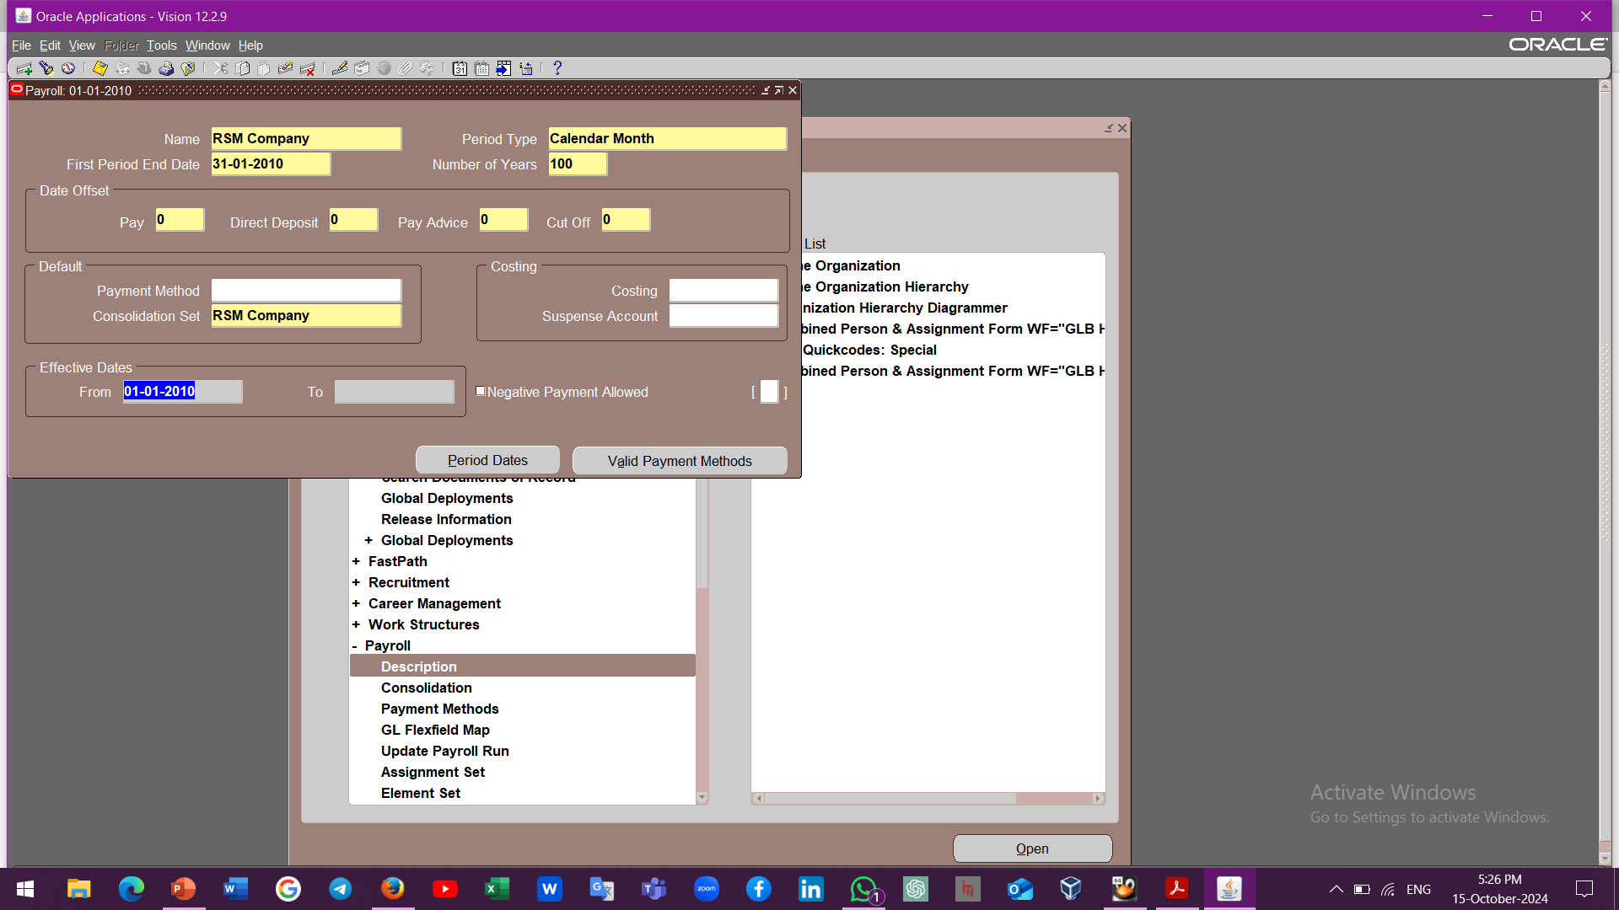
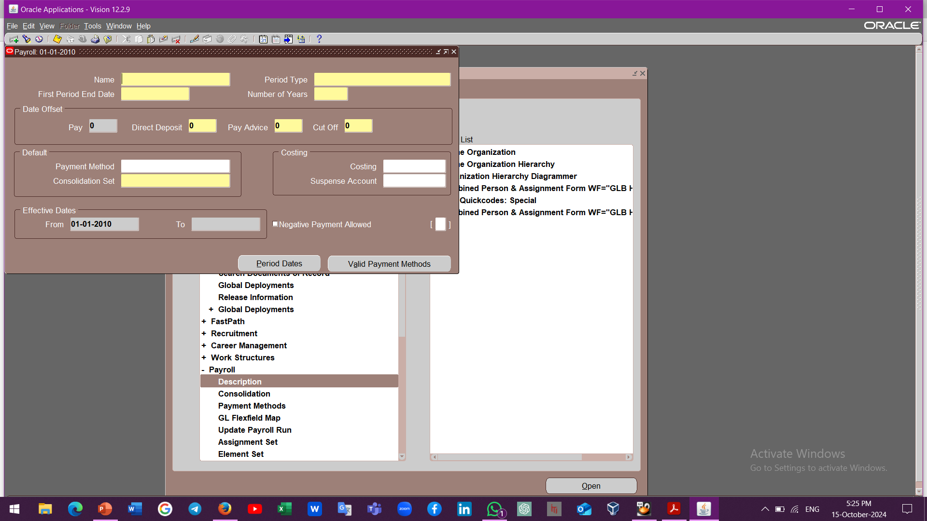
Payroll Creation
3
1
2

Slide 25
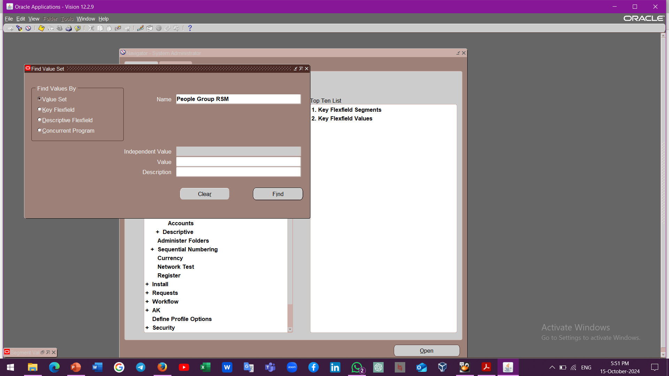
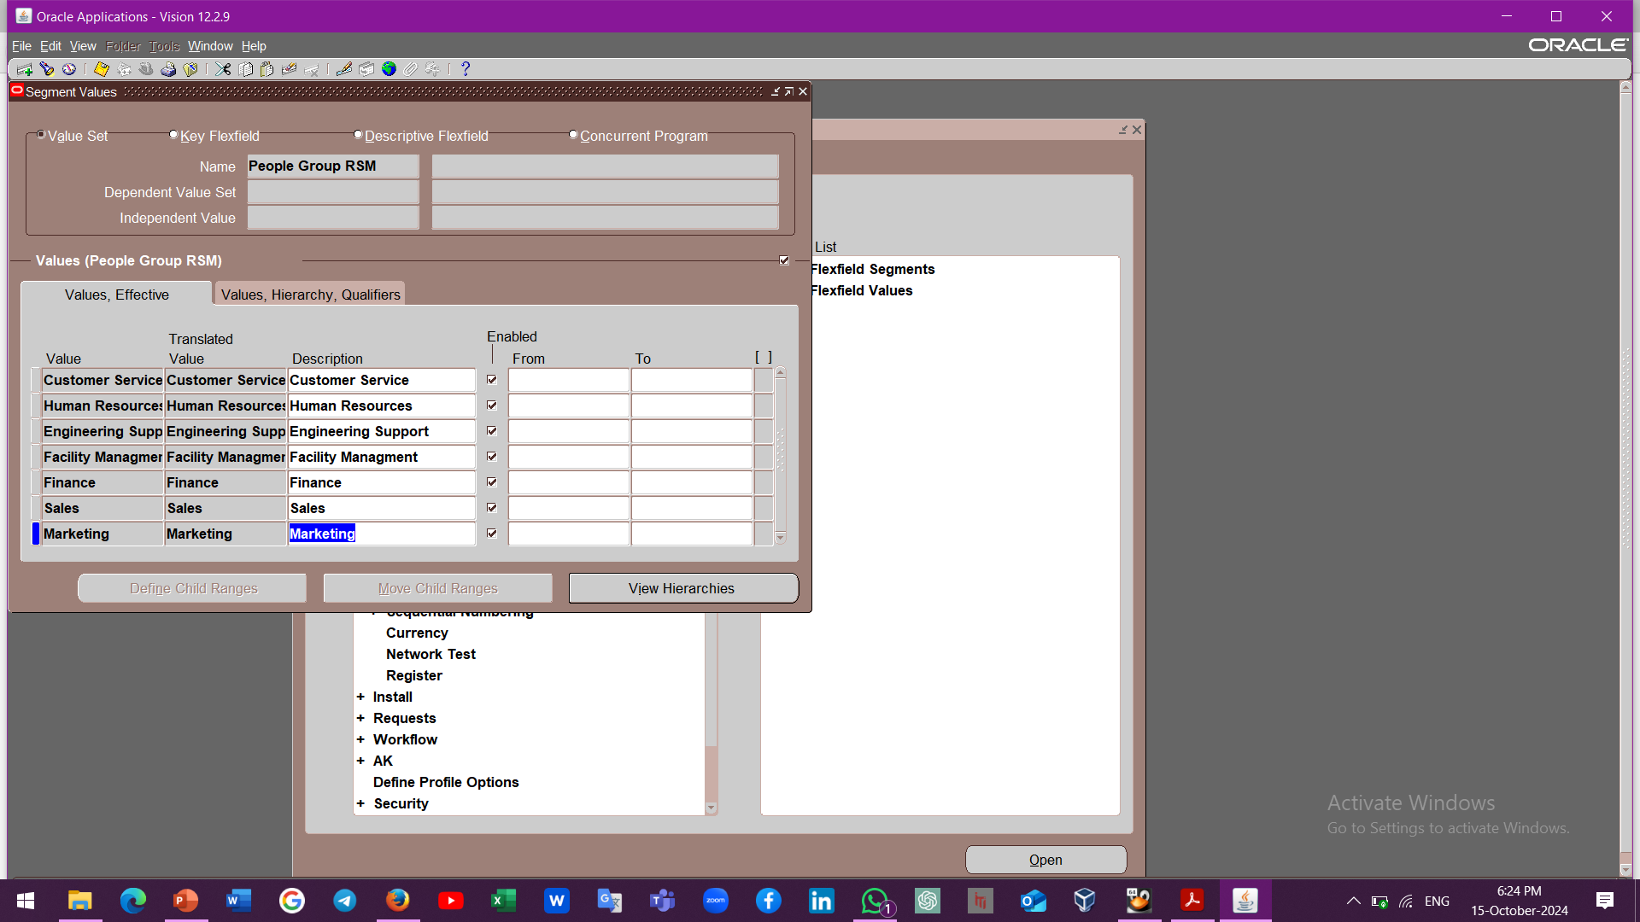
People Group Creation

Slide 26
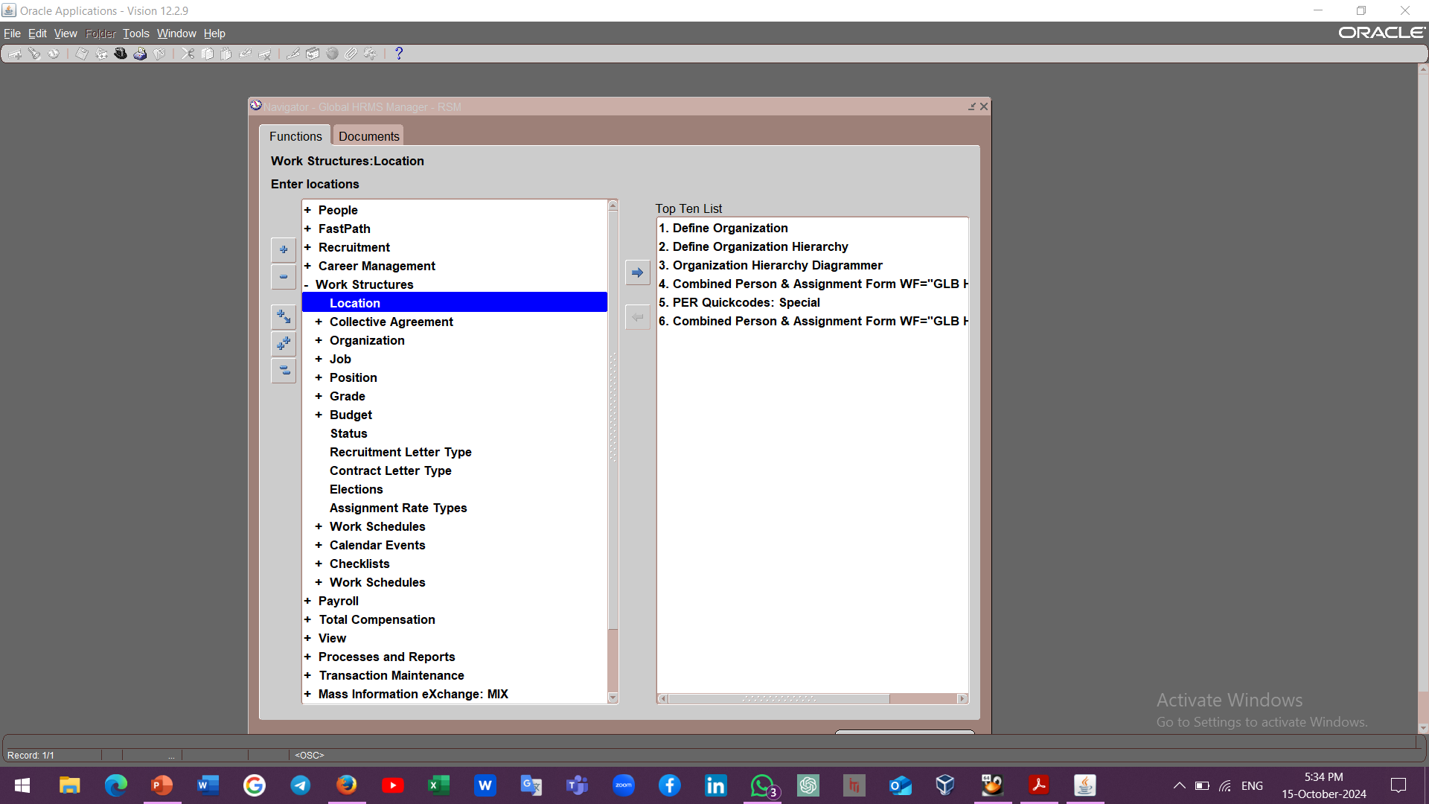
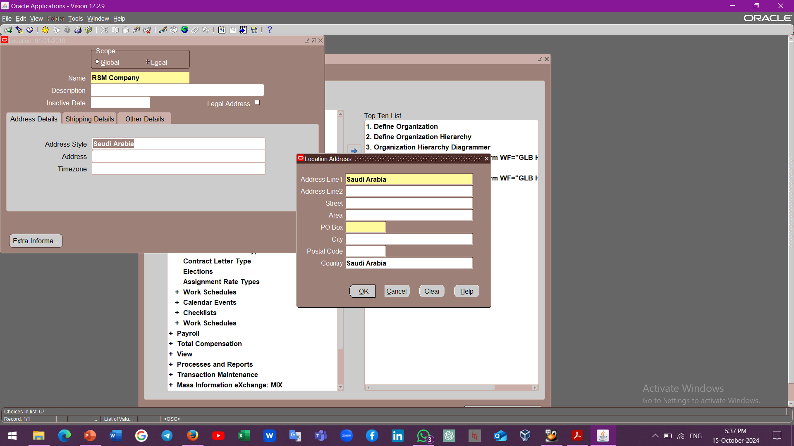
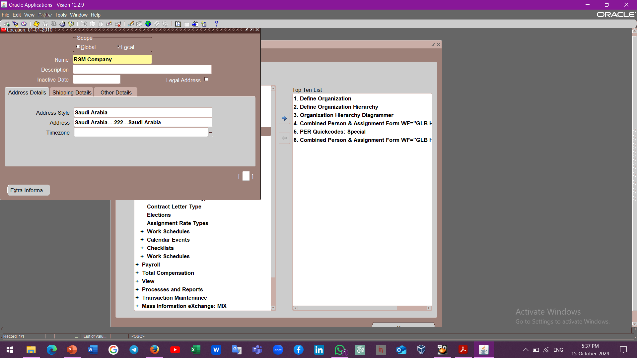
Location Creation
2
1
3

Slide 27
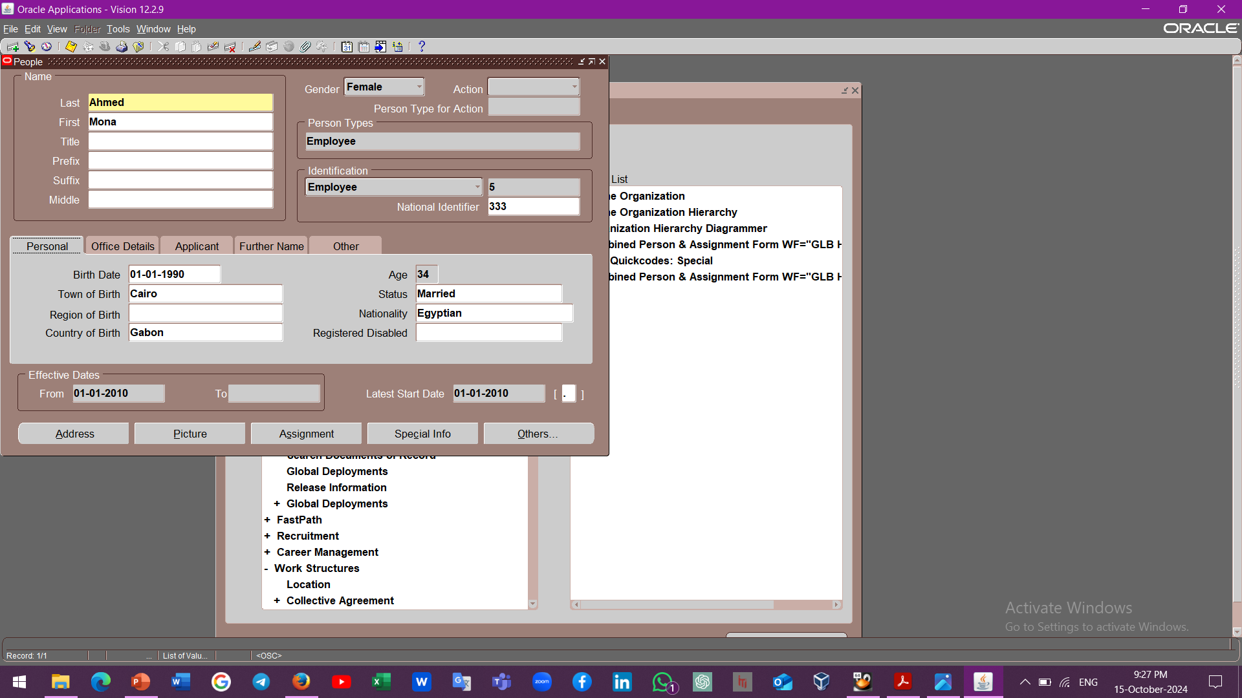
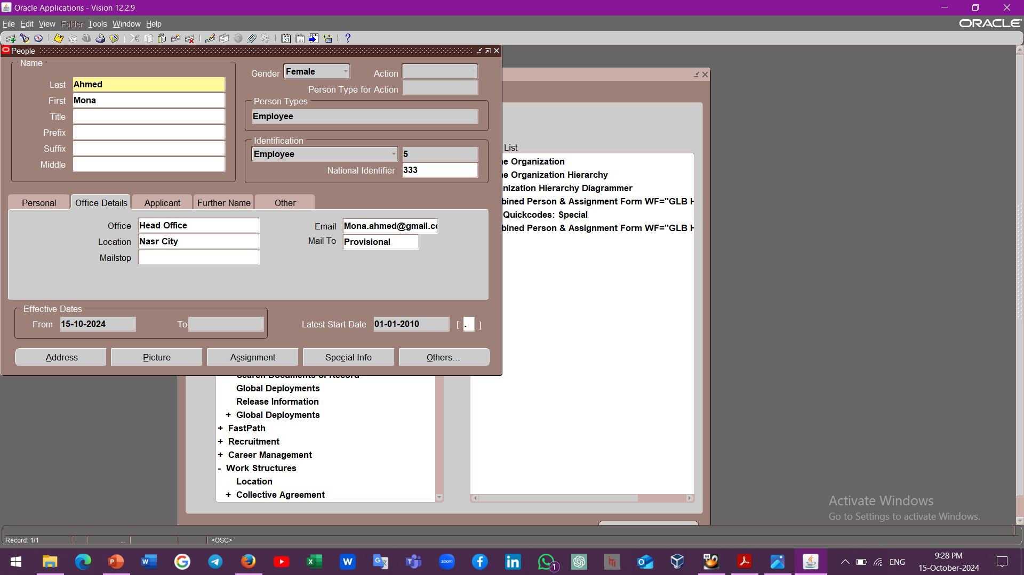
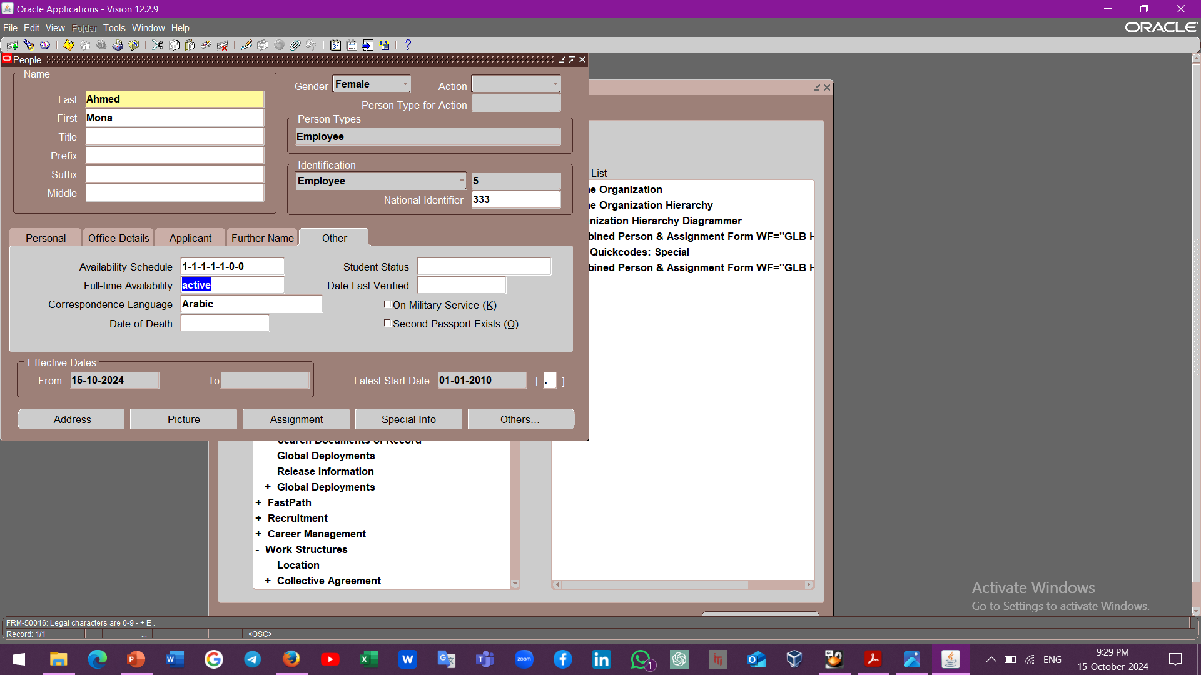
Workforce Planning and Reporting
Global HRMS Manager
People
Enter and Maintain

Slide 28
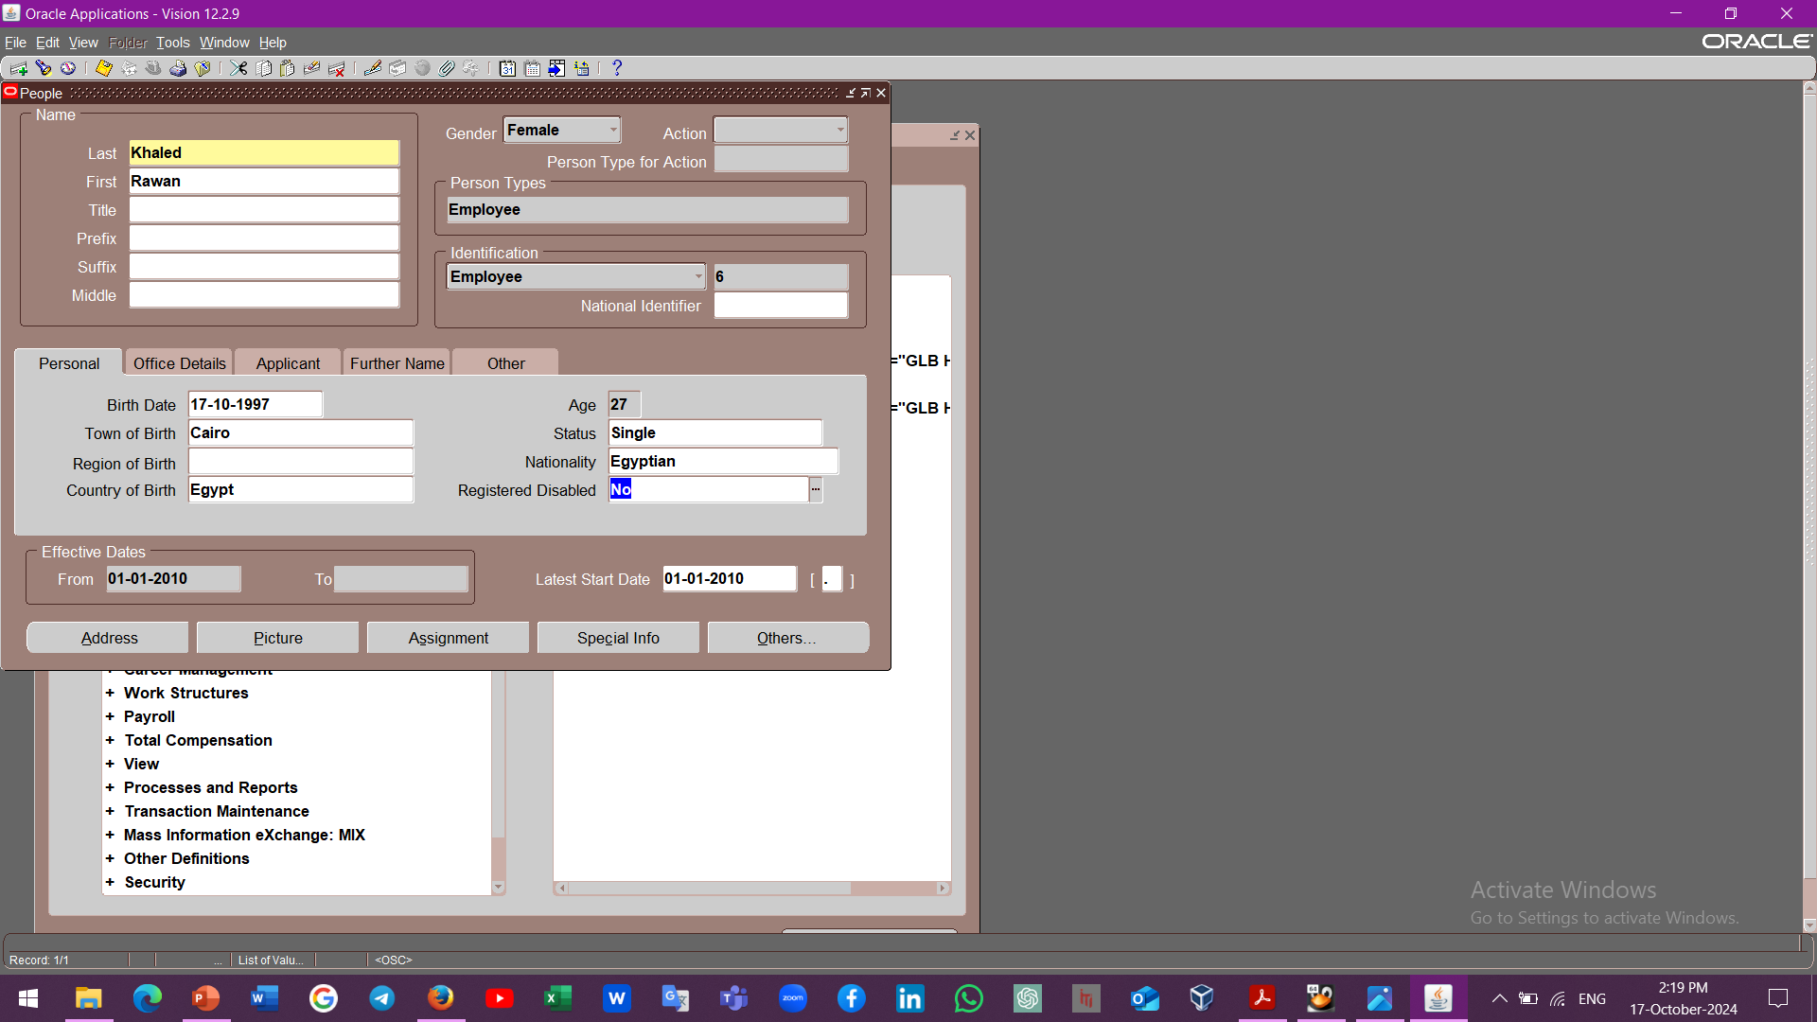



Workforce Planning and Reporting
Global HRMS Manager
People
Enter and Maintain
Assignment
1
2
3
4

Slide 29




Workforce Planning and Reporting
7
5
6
6
8

Slide 30



Workforce Planning and Reporting
Supervisor Level
For Hierarchy
1
2
3

Slide 31



Talent Management Integration:
2
3
1

Slide 32



Workforce Planning and Reporting
4
5
7
6

Slide 33



Workforce Planning and Reporting
1
3
2

Slide 34



Workforce Planning and Reporting
4
5
6

Slide 35
Notes:
Oracle HCM

